Slide 1
CONTINUING EDUCATION
24-HOUR LIFE & HEALTH
SELF-STUDY PROGRAM
INCLUDING 3 HOURS IN ETHICS

Slide 2
Continuing Education (CE) Classroom Requirement in Utah
The following C.E. requirements are for all Utah resident agents
A total of 24 hours of continuing education are required, of which:
12 out of the 24 hours must be in the classroom or
classroom equivalent type courses;
3 hours must be in ethics training; and the
remaining 9 hours can be in any line of
insurance.
All 24 hours must be from courses approved by
the Utah Insurance Department.
http://insurance.utah.gov/producers/continue_education.html

Slide 3
How Self-Study meets the 12- hour classroom requirement
Self-Study Program: An approved course of study offered to satisfy the 12 hour classroom requirement which can be completed without actual class attendance. Evidence of satisfactory completion must be verified in writing by the provider (me). The provider must verify with the student through a method of testing. If there is not a test given, the provider is not allowed to post your CE credit. This program has been approved through the Utah Department of Insurance.
You will see that the Self-Study PowerPoint Presentation has five Q&A questions at the end of the 11 Units. Please answer the questions on the Self-Study Q&A Worksheet.

Slide 4
Class… Credit… Renewal
Self-Study Class… By completing your online study of the Self-Study PowerPoint Presentation and filling out the Self-Study Q&A Worksheet, you will fulfill the 24 hour credit (including 3 in ethics) for continuing education requirement.
Credit… Your credit can only be posted to the State by an authorized provider/instructor.
After I receive your completed Self-Study Q&A Worksheet and your $150 payment I will post your credit with the State. Payments are received through the website www.LindellCE.com
Renewal… After your credit is posted you will be eligible to renew your license with the State at www.Sircon.com

Slide 5
LICENSE EXPIRING SOON!?
If your license expires in the next few days PLEASE email me right away or call me at (435)272-2021 to make sure I get your credit posted before your expiration date. I can not post date credits.

Slide 6
Unit 1
5 Q’s
Insurance Principles and Concepts
Notes:
‹#›
Unit One deals with basic insurance principles and concepts.
We are going to do a lot of vocabulary and introduction to all kinds of terms in life insurance.
Story the Yangtze River in China the North was agricultural and once a year farmers would have to load their sanpan boats full of their crop down the Yangtze River to sell in the city. At least once during the trip boats would turn over from a storm and one farmer would lose all his crops or assets. A group of farmers decided to put a portion of each of their crops on each of the boats and so if one of the boats was lost each farmer would only lose a fraction of their crop and no one would lose 100% of their assets. Insurance as an idea came from China. This was the beginning of the idea of insurance or risk sharing.
These farmers asked the question: how do we protect ourselves? That is what Insurance tries to handle.

Slide 7
Speculative vs. Pure Risk
Speculative Risk = Possibility of Gain
(Not Insurable)
Pure Risk = Possibility of Loss Only
(Insurable)
Notes:
‹#›
There is a RISK if there is a chance of loss. So from the insurer’s perspective, RISK is the uncertainty or possibility of loss; not the loss itself.
There are 2 kinds of risk:
Speculative Risk:
GAMBLING there’s a chance that you win or chance you lose. In insurance there is not a possibility of any kind of gain.
What is an example… Gambling, someone can not buy insurance that will pay for the lottery ticket if it turns out not to be a winning ticket.
Pure Risk: is the only form of risk insurance deals with. There is only a possibility of loss not gain.
It is unlikely that there are benefits from being in a car accident.
*Star that speculative Risk is not insurable and that pure risk is insurable bottom of page 2! What is an example of pure risk? (car insurance, health insurance) they certainly aren’t going to pay you if you DON’T get in a car wreck or never go to the DR.
* We are only dealing with PURE RISK*

Slide 8
Peril vs. Hazard
Hazard: increases chance of loss
Peril: direct cause of loss
Notes:
‹#›
Insurance responds to pure risk only.
PERIL is the immediate specific event causing loss and giving rise to risk. It is the cause of a risk.
HAZARD is any factor giving rise to a peril.
In the picture what is the PERIL? The FIRE is the actual event causing the loss of the unit.
What is the hazard? All the plug ins are a HAZARD that increase the chance of the peril that causes the loss.
The fire is the PERIL or the actual event that causes the loss.

Slide 9
Treatment of Risk
STARR
Sharing
Transfer
Avoid
Reduce
Retain
Notes:
‹#›
How do we treat RISK?
SHARE the risk. Health insurance is the sharing of risk. Someone pays someone else to share their risk. You get sick so you go to the doctor and because you have been paying your insurance premiums the charges are minimum because you are each giving and taking.
TRANSFER the risk to someone else. The best example of transferring risk is life insurance. If you have life insurance and you have 500K policy, you know that your loved ones are protected in case something happens to you. You are transferring that risk of IF he dies that death benefit will provide. How do we transfer risk …we pay our premium.
To AVOID completely you would have to eliminate the hazard, is that realistic, can we really eliminate risk? no but you can avoid it. What are some examples of avoiding risk? Stop smoking, stop drinking, stop skydiving or scuba diving and driving your car like a banchie… avoid taking risks. You can’t just move out of your house because you don’t want to die in a house fire. AVOID are the don’t.
We can REDUCE our risk. Putting smoke detectors in your home can reduce risk of dying in a house fire. If you are already smoking you could quit smoking or never start in the first place, you can take meds, take a daily vitamin, you can exercise. A person with diabetes can reduce risks with diet and insulin regulation.
RETAIN the risk, you retain the risk, if you don’t have life insurance you retain the risk because you aren’t reducing and are not sharing the risk…
When we have a deductible on insurance, that is part of retaining risk by retaining some of the risk. We pay the deductible on auto insurance or on health insurance you have a $5,000 deductible. You retain some of the risk by paying the deductible, or retain all the risk by not having any insurance at all.
Go back over the STARR and give examples of each. Very testable, paying your deductible is an example of_______________

Slide 10
6 Characteristics of Insurable Risk
Large loss exposure
Definite and measurable
Chance PURE RISK
Predictable
Not catastrophic
Random
Adverse selection
Notes:
‹#›
The loss must be definite and measurable. Most insurance companies won’t write a policy on a pen, there has to be a loss that has to be definite and measurable something you can put a cost on.
Only a CHANCE of loss (back to PURE risk) there has to be a probability of loss. Will an insurance company write a policy on a terminal cancer patient, not if there is not a chance that he is going to survive. It also must be uncertain, you don’t know how or when someone is going to die.
Everyone is going to die, it is predictable.
NOT CATASTROPHIC – 9.11 the world trade centers, acts of terrorism, Katrina, most insurance companies don’t cover catastrophies. Insurable risk must be NON CATASTROPHIC
Adverse selection explains that healthy people don’t want insurance and they are good risk. Poor risk is those that are older and have health issues, so they are more likely to want insurance.

Slide 11
Large Loss Exposure or Law of Large Numbers
This is a law of statistics.
The more people we have in the insurable group the more accuracy when predicting how many losses will occur within that group.
Notes:
LARGE LOSS EXPOSURE means the LAW OF LARGE NUMBERS: this is a law of statistics. The more people we have in the insurable group the more accuracy when predicting how many losses will occur within that group. The more white men non smokers office working 55 year olds, the more they can put people in pools so that they have a greater prediction that this guy will probably live to be 72 years old. This is a universal law!
‹#›

Slide 12
Types of Insurers
Mutual
Stock
Reinsurer
Self Insurers
Participating
Non-Participating
Insurance Company’s Insurer
Retain own risk
Lloyds of London
Notes:
MUTUAL COMPANIES (policy owners participates, the dividends are paid out to the policy owners and are non taxable)
STOCK COMPANIES (stockholders) the policy owners are non-participating -- no dividends.
Lloyd’s of London: Lloyd’s of London is not an insurance company. Lloyds of London does reinsurance; an insurance company’s insurer. Celine Dion has smaller policy on her voice so in case she can’t sing they will still pay her in case she has to cancel her show. Bellagio has millions of dollars in artwork they have building insurance for floods or fire, on specific artwork. The reinsurance will come in and write specific insurance on these individual works of art.
SELF INSURER you don’t have any insurance, or catastrophic medical insurance, maybe if you get in a really bad car accident or need surgery that covers it, there is a big deductable because it’s not for a broken finger it’s for a ton of money in medical bills.
‹#›

Slide 13
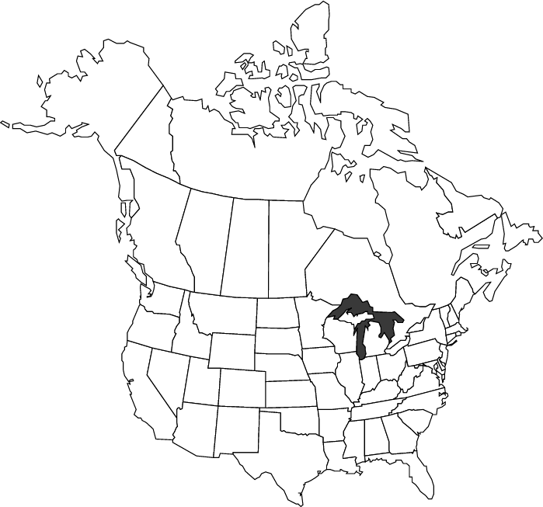
Domestic/Foreign/Alien
Notes:
Insurance companies are classified by geography either domestic/foreign/alien.

Slide 14
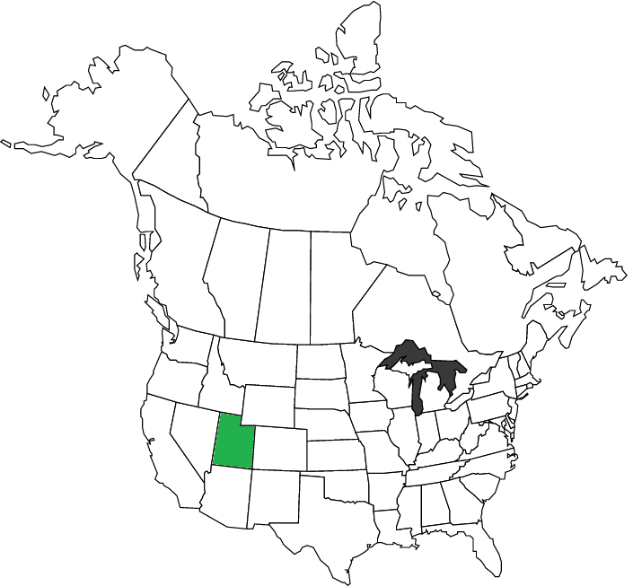
Domestic
Notes:
Domestic companies: the insurance company is organized under the laws of that state.
What are some examples: DMBA/IHC select care. In THE STATE of UTAH or state specific.

Slide 15
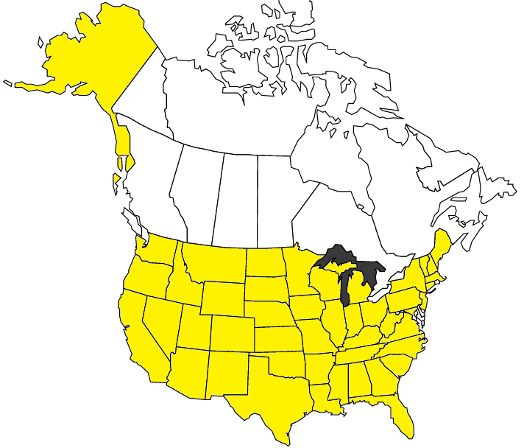
Foreign
Notes:
Foreign insurance company organized under the laws of a different state, territory or possession. Their headquarters are not in your state that the insurance is issued. Primerica is a foreign company with their corporate/home office in Georgia and they can still sell insurance here in Utah.

Slide 16
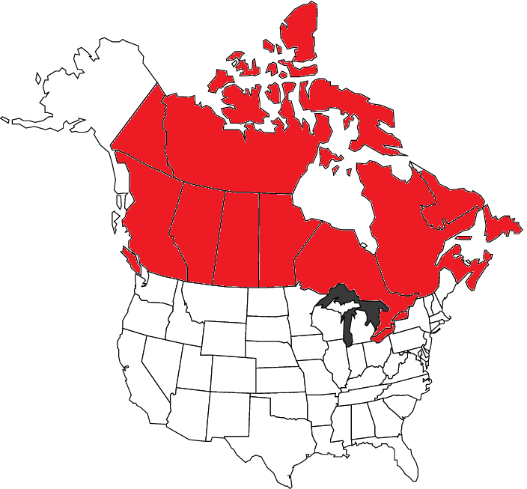
Alien
Notes:
Alien insurers are organized under the laws of any jurisdiction other than a state of the United States. Those that have their corporate office out of the country.

Slide 17
Regulation of Insurers
AUTHORIZED INSURER
are solely state regulated
Certificate of Authority (license) is issued by state Department of Insurance
Insurer is then called licensed or admitted or authorized
An unauthorized insurer does not hold a certificate of authority in that state and can not transact insurance.
Notes:
‹#›
Only an authorized insurer, can sell life insurance…
Each state has a department of insurance, that is led by the commissioner who is assigned by the Governor for a 4 year term! VERY IMPORTANT. Authorized insurers can sell life insurance as long as they have a certificate/license of authority issued by the Dept of Insurance

Slide 18
AGENT AUTHORITY
Express Authority – powers granted in the agency agreement (signing agent agreement)
Implied Authority – must have to do your job (collecting premium)
Apparent Authority – what the public reasonably believes an agent can do (business card)
Notes:
After you are life licensed then you have authority to do more things.
Express Authority – powers granted in the agency agreement
Your agent agreement is your company contract that gives you the authority to act in the company’s name
Implied Authority – must have to do your job
Collecting Money/premium
Apparent Authority – what the public reasonably believes an agent can do
Business cards makes the customer believe you have authority, your insurance certificate/license
YOU REPRESENT the insured, not the insurer! Agents represent the insurance COMPANY!

Slide 19
Offer and Acceptance
Company accepts and issues the policy
Applicant’s initial premium & application
Offer
Acceptance
Notes:
Why do we have to have a written contract? SO THAT IT IS LEGALLY BINDING! You want something that is signed between both the insurer and the insured.
How does insurance handle legal contracts?...
First we have to have an offer which is the applicant’s initial premium and application that is the OFFER to the insurance company.
OFFER = application and premium.
The ACCEPTANCE = Company accepts and issues the policy, ACCEPTANCE is the ISSUANCE and DELIVERY of the policy.

Slide 20
Characteristics of Insurance Contracts
Conditional
If…then phraseology
Unilateral
One way; one party performs and the other only pays
Adhesion
You are stuck with it
Protects insurer against agent misstatements
Aleatory
exchange of unequal values
Personal
Contract between individual and the insured
Notes:
‹#›
Insurance applications have to be Conditional “if…then”.
If everything comes in clear then we will insure you. No we found the bloodwork you have cancer we won’t cover you. There is a medical part to the application, swab or blood. They process that information and they weigh the risks and if you are insurable then they accept the app and issue the contract.
Contracts are UNILATERAL. The insurance company has to perform as long as you pay. If you die then the company pays.
ADHESION a policy can not be changed by the insurer. They issued it they are stuck with it. Can not add exclusion if the policy has already been issued (skydiving).
Policy has to be considered ALEATORY. Your premium will not match your death benefit, the insurer has a greater value risk.
PERSONAL the policy will be for YOU. Would you want to get a policy on your dad? No his premiums are going to be way more than yours. They are individually issued. If we have one flat fee we would have to pay for the older people’s premiums. Contract law says that they have to be personal contracts so that the premium is appropriate. You pay for what you are.

Slide 21
Warranties and Representations
Warranties
Statement guaranteed
Representations
Statement on application
True to best knowledge of applicant
Test of materiality
Notes:
‹#›
Utmost Good Faith the insurance company is counting on your good faith and then you are counting on them to give you good insurance.
Warranties: the statements were true and couldn’t change. (you are female)
Representations: were true at time of application. That it is true to the best knowledge of the applicant at time of application. Someone is going through the medical questions on the life app. The paramed then comes out and draws your blood and it comes back that you have leukemia, now the insurance company won’t pay you. You should reveal as much as possible.
Misrepresentations: could be mistakes or lies, if misrepresentations are made they do a…
TEST OF MATERIALITY: the misrepresentation has to be relevant to getting life insurance and it has to be material in that the insurer would have charged higher premium based on what was found. The real question is would the company have made a different decision if they would have known the truth.
CONCEALMENT or withholding information. Misrepresentation you are overtly lying. With concealment you are telling part of the truth and withholding some information.

Slide 22
FRAUD, WAIVER, ESTOPPEL
FRAUD – intentional act designed to deceive and induce another party to part with something of value (without any intent to obtain something of value, no fraud has occurred)
WAIVER – intentional and voluntary giving up of a known right
ESTOPPEL – the legal consequence of a waiver. One party who has given up a right may be blocked (or stopped) from changing conduct and reasserting the right, after another party has begun to rely upon it, if doing so would be to the detriment of the second party.
Notes:
‹#›

Slide 23
Unit 1 Review
Insured/Insurer
Law of Large Numbers
Risk – Pure vs. Speculative
Peril vs. Hazard
Handling Risk - STARR
Elements of an Insurable Risk
Expressed vs. Implied vs. Apparent
Elements of a Legal Contract
Notes:
‹#›
Who is the insured on an application or policy? THE APPLICANT or POLICY OWNER
Who is the insurer? The COMPANY
Someone give me a quick definition of the Law of Large Numbers: Greater number you have in a group the more accurate you can predict the chance of loss.
Give examples of Pure and Speculative Risk and Peril vs Hazard. Which one does insurance companies cover? PURE RISK!
GO OVER STARR and give examples: Sharing, Transferring, Avoiding, Reducing and Retaining
Go through the elements of an Insurable Risk: Law of Large Numbers, measurable loss, definite, pure risk.
Give an example of your expressed authority: your agency contract Implied Authority: collecting premium Apparent Authority: business cards.
Elements of Legal Contract: Offer (Application + premium) and Acceptance (Issue and Delivery of policy).

Slide 24
Q&A
1. Which of the following insurance concepts is founded on the ability to predict the approximate number of deaths within a certain group during a certain time?
A. Principle of large loss
B. Quantum insurance principle
C. Indemnity
D. Law of large numbers
From UNIT 1
Notes:
‹#›
Answer is D
Remember that the law of large numbers is predictability - the more applicants the more accurate.
D is the definition of Law of large numbers.

Slide 25
Q&A
2. Wearing a seat belt is an example of
A. adverse selection
B. risk reduction
C. indemnity
D. risk avoidance
From UNIT 1
Notes:
‹#›
Indemnity is a fancy word for LOSS.
When you are driving a car can you completely avoid all risk? No so it is reducing the risk only.
Answer is B

Slide 26
Q&A
3. If an insurance company in Utah is
known as a domestic company where
are their home offices located?
A. In Georgia
B. In Utah
C. Outside of the USA
D. In the USA
From UNIT 1
Notes:
‹#›
Answer is B

Slide 27
Q&A
4. Collecting premium is an example of
what form of agent authority?
A. Obvious
B. Expressed
C. Apparent
D. Implied
From UNIT 1
Notes:
Answer is D
Implied Authority
‹#›

Slide 28
Q&A
5. Signing your agent contract is an example of what form of agent authority?
A. Obvious
B. Expressed
C. Apparent
D. Implied
From UNIT 1
Notes:
Answer is B
Expressed Authority
‹#›

Slide 29
Unit 2
5 Q’s
Application, Underwriting, and Policy Delivery
Notes:
‹#›
Unit TWO will be talking about the Application’s transformation process as it turns into a policy.

Slide 30
Costs Associated with Death
Doctor/hospital bills
Funeral expenses
Estate taxes
Debts
Continuing income needs for the family
Children’s education (future)
Retirement income (future)
Notes:
$15,000 is the average funeral expenses, dying is the most expensive experience you will never get to deal with!
All these costs are associated with death… read slide…
Death is expensive!
$15,000 is the average now for basic funeral costs.
Utah does not have a death tax there is only federal taxes and it’s based only on how much you are worth if they tax you or not.
‹#›

Slide 31
Determining the Amount
Human Life Approach – How much will insured make? The breadwinner
Needs Approach – How much will survivors need? Primerica and FNA determines this, how much coverage is the survivor going to need.
Notes:
How do we determine the amount of insurance someone needs?
Based on these questions and these two approaches.
‹#›

Slide 32
Important Parties
Applicant
Insured
Policyowner
Beneficiary
Notes:
‹#›
The APPLICANT is applying for life insurance. The Applicant could become the insured, but they are not always. The Applicant will become the owner of the policy and the insured would be the actual person that is going to be insured. That is the difference between the two. You could be the applicant and the insured. You could be the owner and the insured.
Do the applicant and the insured have to be the same person? NO! Child and parent/ex-spouses with insurable interest! On a dependent like your elderly mother that you are taking care of now and have resumed responsibility for all her assets debt etc.
Policyowner is the one paying the premium.
Beneficiary will be the one that collects the death benefit. Beneficiary has to be 18 years old. Children under age 18 CAN NOT be a beneficiary.

Slide 33
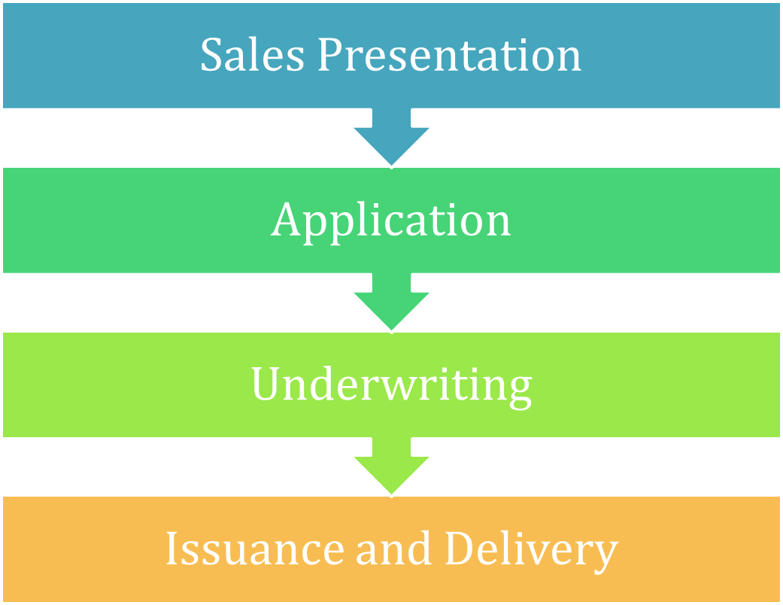
Putting a Life Policy into Effect
Notes:
‹#›
Life insurance process
We have talked about important parties. Now we talk about the application turning into a life policy. You can’t just get it online or order it in the mail.
GO OVER SLIDE WITH THESE DEFINITIONS:
Sales Presentation= agent with the company approaches client and explains product and why they need life insurance!
Application= agent completes application with client and premium is taken (height and weight)
Underwriting= the company must obtain information about the client and answer the question…are they insurable? are we going to insure them? they will accept or decline the application. If they say yes the client is insurable and the company issues the policy.
ISSUANCE and DELIVERY =company issues the policy to the agent. The agent delivers the policy. If declined they can file a reconsideration or an exception.
THIS IS AN OUTLINE OF WHAT WE WILL BE GOING COVERING IN THIS UNIT.

Slide 34
“Problem” Applications
Changes in the application
Applicant must initial
Consequences of incomplete applications
Delay in underwriting
Return to agent
Possible waiver of content
Notes:
‹#›
Go over slide…cross it out and have the client initial it.

Slide 35
Sources of Insurability Information
Part I of application— General
Part II of application—Medical
Part III of application—Agent’s Report
Notes:
‹#›
Part I of application—General
Name, DOB, SS#, address etc
Part II of application—Medical (or NON medical)
Medical questions on the application
Not really medical, the agent does not have medical training and the applicant is telling the best of their knowledge.
Part III of application—Agent’s Report
Physical exam (or paramedical exam)
Saliva swab
Blood, Urine & Vitals
Possible EKG
Attending Physician’s Statement (APS)

Slide 36
Sources of Insurability Information
Physical exam (or paramedical exam)
Attending Physician’s Statement (APS)
Medical Information Bureau (MIB) Report
Notes:
‹#›
CONTINUING AGENT REPORTS
Medical Information Bureau (MIB) Report
non profit database that collects medical information for life and health insurance, underwriters can go there to check medical history. The client signs a waiver that their medical history will be checked during the application process. The privacy notice HIPAA form you fill out at the DRs office you sign that says that the DR won’t release information unless the request for your records has your signature on it. That is why we have the waiver.
You will run into several different things in underwriting, don’t be afraid or ignorant to the fact.

Slide 37
Sources of Insurability Information
Consumer (Inspection) Report
Provides three Cs
Credit
Criminal
Character
Notes:
‹#›
Consumer (Inspection) Report
Provides three Cs
Credit
Make sure you can make your premiums
Criminal
Felonies
Includes Driving record! DUIs?
Character
Reasonable Person
Make sure your client understands what information you are collecting

Slide 38
Fair Credit Reporting Act (FCRA)
Protects individual right to privacy
3 guarantees
Notice to applicant
Source of negatives
Right to refute
Nature and scope may be requested
Notes:
‹#›
Does everyone have a credit card, it is the right to privacy, every time anyone pulls your credit they have to have this privacy notice.

Slide 39
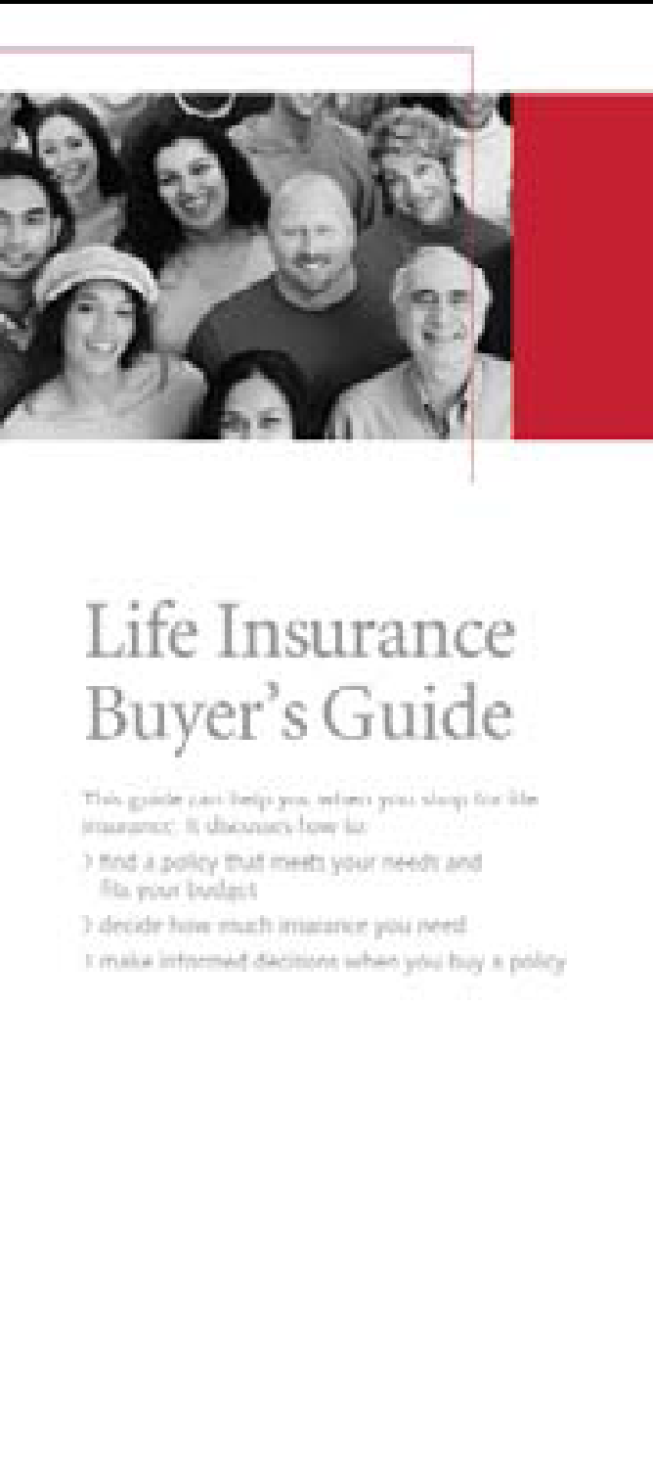
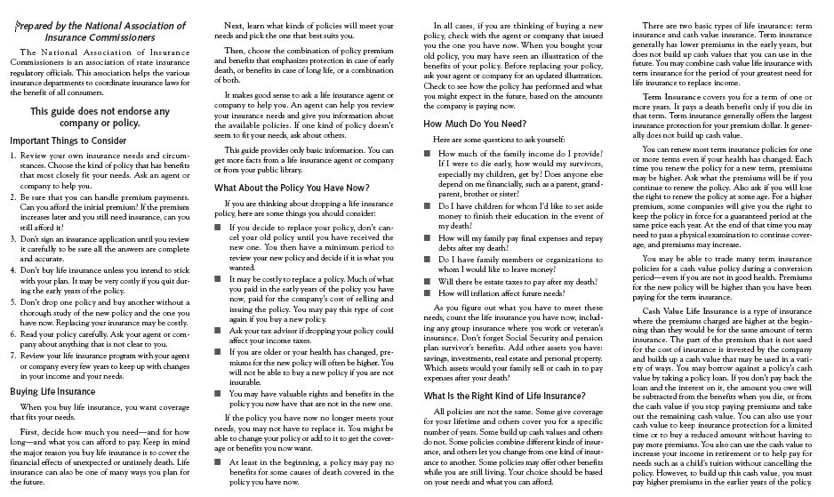
Disclosures at Point of Sale
Buyer’s Guide
Outline of Coverage or Policy Summary (specific to the policy being purchased)
Notes:
‹#›
Buyer’s Guide –
Outline of what they purchased, very general information about their policy
PRIVACY BROCHURE and Papers in the back of the app

Slide 40
HIV Testing
Written consent required (good for 6 months)
Applicant must be notified that testing will occur and what testing methods are used (swab tests and blood tests test for illegal drugs, nicotine, and HIV
Testing is done at the insurer’s expense
Testing and results must be kept confidential
“Abnormal blood test” reported to MIB (not HIV/AIDS Positive)
If the policy is issued, AIDS or HIV cannot be used by the insurer as an exclusion
Insurers cannot discriminate; can not ask for sexual orientation
Notes:
How do insurance companies handle HIV testing? READ SLIDE…
‹#›

Slide 41
Submitting the Application
Non Pre-payment Application
Notes:
‹#›
Goes from Application to full policy.
Go over the conditional receipt, if the premium is received with the application or PRE PAID APPLICATION.
If NON PRE PAID then they have to do STATEMENT OF GOOD HEALTH and the applicant is only covered after premium received and Delivery receipt.

Slide 42
Collecting Initial Premium and Issuing Receipt
Conditional receipt
Given when application is complete and the initial premium has been paid
Coverage begins date of application or medical exam, whichever is later, IF the company issues the policy as applied for.
Notes:
‹#›
Conditional receipt portion of application
Begin on the date of policy or medical examination, whichever date is later, as long as they are medically insurable OR if the company issues the policy
* Prepaid application- conditional receipt
* Non-prepaid application- not a conditional receipt if you don’t get premium payment with application

Slide 43
Sources of Underwriting Information
Application
Medical exam
Attending Physicians Statement
Agent’s report
MIB
Consumer Report
Credit
Criminal
Character
Notes:
Review of Insurability information
‹#›

Slide 44
Insurable Interest
Financial Stake “Blood or Money”
Self
Spouse
Business Partner
Children (close family)
When?
ONLY at the time of application
Notes:
Do you have a Financial Stake or Interest? Can you be the policy owner over these people?
– self, spouse, business partner, children, ex-spouse (close family-but have to have financial stake) Must have a blood or money relationship!
When does insurable interest have to occur? ONLY at the time of application.
Example: a couple wants to divorce if he never changes the policy and takes spouse off as beneficiary when he dies the first wife gets the death benefit.
Children: it asks their relationship and if they live with them.
BENEFICIARIES: anyone can be assigned as beneficiary
If a person remarries, the application stays as originally written unless changed
Aristocats movie she leaves the policy to her cats
‹#›

Slide 45
Moral vs. Morale
Moral hazard
Applicant is dishonest
E!
Morale hazard
Applicant is careless/indifferent
Notes:
When evaluating the risks the underwriters see several things and have to make judgments.
What is a hazard again? any factor that could add risk to the actual loss
Moral hazard: if the applicant lies about health history, health habits, or occupational risk exposure, there might be a higher risk
Morale hazard: there might be a higher risk if the client is indifferent or careless, like if they have speeding tickets, DUIs, or an apathetic attitude toward health or safety.
‹#›

Slide 46
Classification of Risks
Preferred • Standard • Substandard • Declined
Notes:
‹#›
Now the insurer and underwriter need to determine what kind of risk the company has. what is the client’s premium going to be. Preferred/Standard/Substandard or the client could be declined.
PREFERRED gold star - really healthy no dangerous occupations or hazards. Premiums are going to be lower.
STANDARD maybe a little older, height and weight might not be right on silver stars. Premiums are going to be average.
Bronzers, SUBSTANDARD they are RATED, have an additional risk, skydivers, scuba divers, height and weight. Premiums are going to be higher based on those several different factors.
DECLINED not insurable.

Slide 47
Premium Determination
Mortality
Interest
Expenses
Mortality – Interest + Expense = Premium components
Notes:
Mortality
- Mortality Tables based on the law of large numbers how long will you live based on mortality tables
Interest
- How much they will make on the policy investing your premiums
Expenses
- How much it will cost the company
Changes to policy and processing it initially
Monthly draft vs. Annual Bill – cheaper to do annual bill
‹#›

Slide 48
Delivering the Policy
Explain the policy (provisions, riders, exclusions)
When coverage begins
Statement of good health
Required when premium is not paid with application
Delivery stops if not signed
30-day free look
Notes:
‹#›
When you deliver the policy. Don’t read the whole thing to them. You have to go over riders, exclusions, when their coverage begins.
On Non prepaid application the statement of good health is required and will be one of the papers they need to sign in the policy with the delivery receipts.
You will tell them about the 30-day free look period. They have 30 days from after delivery of receipt. The client can cancel and get premium and policy is returned. After the 30 days they can cancel but the premium will not be returned.

Slide 49
Q&A
6. Which of the following is the effective date of coverage for an applicant who has been issued a conditional receipt?
The date of application or the date of the medical exam, whichever is later, if the application is approved as applied for
The date the producer receives the policy from the insurance company
The date the producer accepts the prepaid application
The date the producer delivers the policy
From UNIT 2
Notes:
‹#›
Answer is A
Not C because we don’t know the date that they accept.

Slide 50
Q&A
7. Changes to a insurance application after it as been completed must be
Initialed by the agent only
Approved by the company’s Regional Vice President
Initialed by the applicant
Approved by the underwriters
From UNIT 2
Notes:
‹#›
Answer is C
Applicant always has to initial.

Slide 51
Q&A
8. An agent writes an application on a prospective client and collects the initial premium. The client completes the required physical exam a week later. The client dies two days later. The policy issues the next day as applied for. What will the insurer pay?
Return the initial premium
The full death benefit
Nothing
A portion of the death benefit
From UNIT 2
Notes:
‹#›
Answer is B
If the policy was declined, the client would receive their initial premium.

Slide 52
Q&A
9. Under what circumstance would an insurance applicant be asked to submit a signed statement of continued good health?
A. When the initial premium is not submitted with the application
B. When the policy is underwritten as substandard
C. In order to receive a preferred rating
D. When an inspection report is ordered
From UNIT 2
Notes:
‹#›
Answer is A

Slide 53
Q&A
10. A producer analyzes Maria’s life insurance needs, taking into account her net annual salary, expenses, current age, and depreciation of the dollar over time. This producer was using:
A. The analytical approach
B. The human life value approach
C. The needs approach
D. The planning approach
From UNIT 2
Notes:
‹#›
Answer is B
They are looking at the breadwinner not the survivors therefore it is the human life value approach.

Slide 54
Congratulations you have made it through Unit 2! Take a 15 Minute Break
Notes:
‹#›

Slide 55
Unit 3
5 Q’s
Life Insurance and Types of Policies
Notes:
‹#›
Chapter 3 and 5 will contain over 60% of the test question answers
We are now talking specifically about LIFE insurance and different types of policies.

Slide 56
Life Insurance History
1900s door to door salesmen
1940s came term insurance.
After WW2 people started living longer and thinking about retirement whole life insurance.
1960-1970s Consumer wanted flexibility universal life insurance.
1990’s Annuities are talked about a lot on the test but they are on the test and they are not life insurance policies.
Notes:
Life insurance came around early 1900s, from door to door salesmen to the 1940s and along came term insurance.
After WW2 people started living longer and they want to have life insurance and want to retire and along came whole life insurance with cash value options.
1960-1970s we want more flexibility, we want to determine more about the premium and so here came flexible and universal life insurance.
90’s came and so did the annuities. Annuities are not life insurance policies.
We have gone from tiny little policies to giant policies with 100s of thousands or millions of dollars for retirement policies.
Term insurance is popular right now. We are talking about different types of insurance in Unit 3.
‹#›

Slide 57
Classification of Life Insurance
Individual (ordinary)
Group
Credit
Industrial/Ordinary (home service)
Notes:
‹#›

Slide 58
Term Life Insurance
Protection for limited number of years
Typically 1, 5, 10, 20, or 30 years
Premiums are level for insured period
No cash value
Provides pure protection
Maximum benefit for lowest price
Notes:
‹#›
No cash value portion. Buy term and invest the rest.
It is TERM because it covers you for a set amount of time and the premiums are ALWAYS level for that period of time. The death benefit is only payable if the insured dies while the policy is in force. That is PURE insurance = only death benefit, no cash value. Most amount of coverage for protection for price.

Slide 59
Types of Term Insurance
Level Term
Increasing Term
Decreasing Term
Premium Stays the SAME!
Notes:
‹#›
TERM INSURANCE *** PREMIUM STAYS THE SAME ALWAYS ONLY THE FACE AMOUNT IS CHANGING
Level term: Premiums stay the same. The death benefit or face amount can stay the same, increase or decrease over the duration of the policy.
Increasing term: death benefit goes up and the premiums stay the same (usually not sold alone you add it as a rider to an existing policy) we will talk about this more later. Pay more up front than what you are getting but then in the end it evens out for you.
Decreasing term: death benefit goes down and premium stays the same (mortgages) they want the death benefit to go down as they pay off the mortgage. As their need for more insurance decreases so does their desire to pay the full premium.

Slide 60
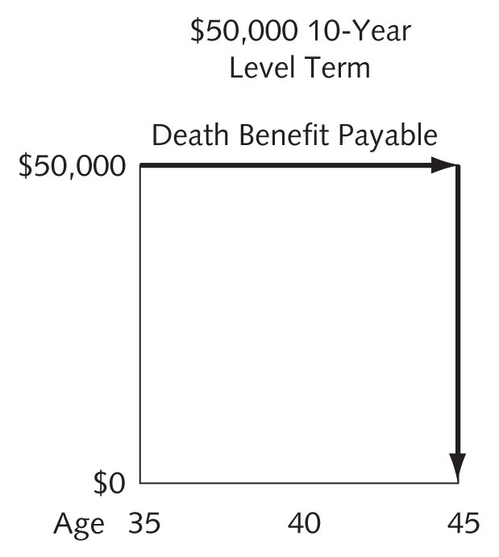
Level Term
Level death benefit/face amount for period of contract
Level premium for period of contract
Premium rate increases with age
Notes:
‹#›
Never see a premium increase and the face amount does not change either over the term.
Level term: Premiums stay the same. The death benefit or face amount can stay the same, increase or decrease over the duration of the policy.

Slide 61
Increasing Term
Increasing death benefit/face amount for contract period
Level premium for contract period
Usually sold as rider
Examples—cost-of-living adjustment or return of premium
Notes:
‹#›
Death Benefit=face amount
Increasing term policies begin with little or no insurance protection and the face amount grows over time. Increasing is usually added as a rider to another type of policy in order to provide an additional death benefit equal to total premiums paid or some other value. Premiums stay level for the term.
Increasing term: death benefit goes up and the premiums stay the same (usually not sold alone you add it as a rider to an existing policy) we will talk about this more later. Pay more up front than what you are getting but then in the end it evens out for you.

Slide 62
Decreasing Term
Often sold to cover debt
Decreasing death benefit/face amount for contract period
Level premium for contract period
Notes:
‹#›
Premium stays the same the death benefit decreases.
Temporary protection for a set period of time. The amount of protection decreases during the life of the policy, often coincide with the remaining payments to discharge a debt… like a mortgage.
Decreasing term: death benefit goes down and premium stays the same (mortgages) they want the death benefit to go down as they pay off the mortgage. As their need for more insurance decreases so does their desire to pay the full premium.

Slide 63
Special Features of term
Renewable
Convertible
Reentry term
Notes:
‹#›

Slide 64
Renewability Feature
Death benefit/face amount remains the same
Length of protection remains the same
Premium goes up on the basis of attained age for next renewal period
Notes:
‹#›
Renewable term: death benefit and face amount stays the same and the amount of time stays the same but the premium changes as they get older or during the term.
ART = annual renewable term - top page 39
Premium adjusts and goes up after each period.

Slide 65
Convertible Term
Term policy which converts form term to whole life (permanent) at end of term.
Without proof of insurability
Convert before end of term
New Policy premium at attained age
Notes:
‹#›

Slide 66
Re-Entry Term
25 year old male, has $150,000 re-entry term policy. Annual premium is $1200
At age 30, because it is renewable term, your premium jumps to $2000 annually.
If you can prove medical insurability with re-entry you can retain that annual premium you were paying 25.
Once you start having heart problems, your premiums are going up. Then at 40 years old that premium jumps to $3000
Notes:
‹#›

Slide 67
WHOLE LIFE INSURANCE
CASH VALUE POLICIES
WHOLE LIFE POLICIES
PERMANENT INSURANCE
Notes:
So we are moving away from PURE or Term insurance and the next series of policies we are going to be talking about have a CASH VALUE attached to them or a savings portion. Cash Value: any policy that has savings/investment to them
Whole life is known as several different things, CASH VALUE, WHOLE LIFE, PERMANENT, etc
‹#›

Slide 68
Ordinary (Straight) Whole Life
Permanent Insurance
Protection to age 100
Growing cash value
Level premiums
Matures/endows at age 100
Policy ends
Cash value equals face amount and is paid to insured
If insured dies, before age 100 only death benefit is paid, not cash value
Notes:
‹#›
AKA Permanent Insurance
These are promises that whole life makes:
1. They will protect you to age 100,
2. When you pay your premiums you get a death benefit and cash value that will grow.
3. And a level premium it won’t go up.
When a policy matures, at age 100 you will get ONLY the cash value. At age 35 you have $50,000 death benefit/face amount. The premiums are figured so that when you are 100 you get the cash value of the matching amount of $50,000. When you die, you get the death benefit to your survivors.
The cash value you only get when you survive to 100 years old! Sounds pretty good whole life right? Do you think you get the cash value AND the death benefit? If you pay on your whole life for 50 years you have $20,000 in cash value and $50,000 death benefit. If you cancel you get the cash value minus the fees etc. You have to choose either cash value or the death benefit.
REVIEW those 3 promises. And you have to make a choice. Straight whole life is a set interest rate. With term insurance it matures when you die and the benefit is paid to the beneficiary.

Slide 69
Limited Pay Whole Life
Whole life (protection to 100)
Shorter premium-paying period
Examples
20-pay life
Life paid up at 65
Premiums and cash value are higher than continuous-pay whole life
Notes:
‹#›
LIMITED PAY: Whole life protection to age 100, pay higher premium
20-pay life is that you pay the premiums for 20 years and your premiums will be paid up. Your premiums are going to be more but you get it out of the way
Life paid up at 65: means that you will pay all your premium either…
By a period of time
Or by an age.
How to pay whole life: Continuous premium /Single premium/ or Limited Payment. Paying annually is cheaper the company has more money all at the same time to invest for “you”.
He has a whole life policy that has a certain cost. It is a 20 year payment period. OR LIFE PAID UP at 65 he has paid it all at age 65. So you can pay continuous premium that can do a premium check every month. You can do limited pay which you can pay up at age or by a period of time. You can also do a lump sum of premium.

Slide 70
Uses of Whole Life
Forced savings
Permanent insurance protection
Policy owner access to cash values
Loans or “benefit advances”
Paid back or deducted from death benefit
Supplemental source of retirement income
Notes:
Forced savings
Permanent insurance protection
Policy owner access to cash values
The company charges you interest
Loan amount is subtracted from Death Benefit
Supplemental source of retirement income
Because it has cash value we can use it for savings.
You can’t market life insurance as retirement. Cash value does allow you to force savings building up. You do have access to cash value and you can’t take out all of it, and there’s a fee. Can be source of retirement. BUT do you actually get what you are putting into it?
You can take out cash value but it has a fee like a loan against the company. With cash value you might not get it all out. Annual premiums paid versus the cash surrender value.
CASH VALUE IS TAXABLE considered income. If you die you get the whole $100,000. With any kind of cash value policy you can not sell life insurance as a retirement policy.
‹#›

Slide 71
SPECIALIZED WHOLE LIFE POLICIES
JOINT LIFE POLICIES
JUVENILE POLICIES
Written for a specific and specialized reason
Notes:
‹#›

Slide 72
Combination Policies
Survivorship
1 policy
2+ named insureds
Death benefit payable when last insured dies
Joint
1 policy
2+ named insureds
Death benefit payable when first insured dies
Notes:
‹#›
Combination Policies similarities…
Insurance is Level
Age 100
Cash Value
JOINT WHOLE LIFE pays out when the first person dies, and the SURVIVORSHIP WHOLE LIFE pays out when the last survivor/insured dies.
The policy matures when the death benefit is paid out.
LAPSED is when you don’t pay your premium and it’s just hanging there.
It expires when you cancel it.
You could have survivorship on company owners and it will pay out on last survivor.
Mostly for children and mostly for business partners.

Slide 73
Juvenile Policies
Written on the lives of minors
Common type:
Jumping Juvenile
*PAYOR BENEFIT
Notes:
Juvenile life insurance: written on life of child.
The Jumping juvenile policy face amount is meant to jump when the child is 21 without the premium increasing.
Payor benefit: there has to be a policy in place this is usually a rider. The premiums are waived on the policy if the parent dies or gets disabled and can’t pay the premium they waive the premium until the child is 21.
‹#›

Slide 74
FLEXIBLE WHOLE LIFE POLICIES
ADJUSTABLE LIFE INSURANCE
UNIVERSAL LIFE INSURANCE
VARIABLE LIFE INSURANCE
Non traditional policies that have been developed more recently to fit needs of the public
Notes:
Moving on to Flexible policies and moving away from the whole life. Now this is when clients wanted more flexibility in their policies.
On page 45-47 circle these pages and know the differences. We are going to go over the major differences but you will have to study them on your own time in order to really tell the difference in the products.
‹#›

Slide 75
Adjustable Life
Changes can be made ONLY on anniversary date.
Plan Type
Policy Owner Chooses 2 Company chooses 3rd
Face Amount
Premium
Notes:
*Adjustable can take the form of whole or term life.
‹#›

Slide 76
Universal Life
Made up of annual renewable term insurance and Cash Value, but it is permanent insurance
The cost of the coverage will increase annually as the insurer gets older
The expenses (mortality & insurance cost) are deducted first
If the premium does not cover the cost of insurance and expenses, the company will take the difference from the cash value.
Notes:
‹#›

Slide 77
Universal Life
Interest
Premium
Mortality – TERM
(Increase amount)
+
Expenses (Loading)
Cash Value
Notes:
Explain bucket. Annually renewable but with UL premium stays the same. Cash value has interest factor so the cash value CAN grow faster, it can not be guaranteed.
With premiums you can have minimum premium like a credit card you are only paying the minimum you aren’t making a gain. Or you don’t have to pay the premium it is a loan. If you pay premium they aren’t guaranteed then to pay the death benefit.
So say you are only paying the minimum premium you have to pay. $25… the insurance company takes out the expenses and THEN pays the interest on your premiums towards your cash value. If you are paying the minimum only you are NEVER going to build your cash value. If your premiums don’t cover the “expenses” then the company can take the expenses out of your death benefit.
It’s a complicated protection, you will probably do it wrong and it will be all gone. Be smart about it, and you choose again between the cash value OR the death benefit. You will not get both.
You have the option of how much premium to pay. Our target premium or a minimum premium. What are people going to pay? The minimum right! Just like a credit card. Your premium is going up but the cash value is actually growing.
The only way to make UL work is to pay 100% of the premium all the time.
If you are only paying your minimum premium you are only holding your death benefit. If you cancel all that money is gone.
‹#›

Slide 78
Universal Life Features
Flexible Premium
Adjustable Face Amount/Death Benefit
Interest (stock market) sensitive
Target Premium – can pay more than the minimum premium which is the only way that UL really works
General Account
Partial withdrawals or surrenders allowed, HUGE CONSEQUENCES
Two death benefit options:
Notes:
‹#›

Slide 79
Level Death Benefit Option
Option A or 1
Has level death benefit
Choose cash value or death benefit
Option 1 = 1 or the other
Notes:
‹#›
Options 1 and 2 can also be Options A and B.
UL LEVEL DEATH BENEFIT Option 1 either death benefit or cash benefit, ART death benefit level. It has a level death benefit. You don’t get both, either you get the cash value at age 100 or death benefit when you die.

Slide 80
Increasing Death Benefit Option
Option B or 2
Increasing death benefit
Has increasing term
Higher cost
Both death benefit and cash value
B = BOTH
Notes:
‹#›
INCREASING DEATH BENEFIT OPTION
UL option 2 you get both cash value and the death benefit, it has an increasing term rider, the face amount is increasing.

Slide 81
Variable Life Insurance stock market
Fixed Premium
Guaranteed minimum death benefit
General account but premiums are put in separate account
Separate account values fluctuate with the stock market
No guaranteed return on the separate account
Life licensed and securities license required
Notes:
‹#›
Just go over slide

Slide 82
Universal vs. Variable
Flexible premium
Adjustable face amount
Unbundling (transparent) mortality charge
2 death benefit options
Partial withdrawals and loans
Separate account
Variable death benefit
No guaranteed ROI
Life & Securities license required
Notes:
‹#›

Slide 83
Industrial Life Insurance
SMALL face amount
Personal collection of premiums by the agent
Not practical
Notes:
Was popular in the industrial revolution to help pay for last illnesses and burial expenses. Now it is not practical for an agent to go collect small premiums monthly or weekly for a very small or minimal face amount.
‹#›

Slide 84
Credit Life Insurance
Only written for debt amount
Debtor pays premium
Decreasing term
Terminates when debt is paid
Creditor is the owner and the
beneficiary
P. 48
Notes:
‹#›

Slide 85
Q&A
11. The level in level term refers to
A. Premium.
B. Face amount.
C. Cash value.
D. Taxes.
From UNIT 3
Notes:
‹#›
Answer is B
Premiums are always staying level in TERM insurance. The premium and face amount stays level in level term insurance.

Slide 86
Q&A
12. Which type of term policy would be most appropriate for protecting the unpaid balance of a home mortgage?
A. Level term
B. Increasing term
C. Decreasing term
D. Convertible term
From UNIT 3
Notes:
‹#›
Answer is C
Decreasing so that the face amount always goes down.

Slide 87
Q&A
13. A renewable term policy guarantees the insured which of the following?
A. The right to renew regardless of health up to a stated date or age.
B. That the premium will not increase upon renewal.
C. The right to convert to permanent insurance up to a stated date or age.
D. That the coverage will increase without proof of insurability
From UNIT 3
Notes:
‹#›
Answer is A
What is renewable term. You can renew but the premium is going to go up because of age. Just the premium that goes up the face amount doesn’t go up.

Slide 88
Q&A
14. One major advantage of convertible term policies is that they allow the insured to:
A. Pay premiums until the conversion date.
B. A chance to purchase additional insurance at the time of conversion.
C. Keep a temporary policy until the original policy is issued.
D. Change to a form of permanent protection without evidence of insurability
From UNIT 3
Notes:
‹#›
Answer is D
Convertible term… allows you to convert from term to whole life with out insurability. D. Whole life/permanent/ cash value all means whole life.

Slide 89
Q&A
15. Which of the following signifies one of the differences between Universal Life and Variable Universal Life?
A. Cash Value
B. Face Amount
C. No Death Benefit
D. One requires the seller to have a securities license
From UNIT 3
Notes:
‹#›
Answer is D

Slide 90
Unit 4
5 Q’s
Life Insurance Policy Provisions, Riders, Options, and Exclusions
Notes:
‹#›
We are going to go through now what is going to be in the policy. We will go through the provisions, riders, options and exclusions.

Slide 91
Standard Policy Provisions
ENTIRE CONTRACT
INSURING CLAUSE
FREE LOOK
Rights and obligations of the policy owner and insurer under the contract.
No extra costs
Notes:
The standard provisions in a standard policy is like having just a plain CHEESE PIZZA
‹#›

Slide 92
Entire Contract
Policy + application = Entire contract
All statements are representations and not warranties
Modifications or changes can be made if both parties agree, ONLY by executive officer, not the agent
Notes:
‹#›

Slide 93
Insuring Clause
Heart of the contract
STATES:
Who the insured is
Who the beneficiary is
Insurer’s promise
Notes:
Go over slide. INSURER’S PROMISE is the company will pay!
‹#›

Slide 94
Free Look
Right to Examine
Policy Delivered to owner; premium paid
Full refund if returned for any reason
30 Days
Notes:
‹#›

Slide 95
Consideration Clause
$$$ Premium Payments & Statements in the application in exchange for
$$$Companies promise to pay
Notes:
Consideration Clause, consideration is an exchange the insured will pay premiums and the insurer will pay the face amount.
‹#›

Slide 96
Policy Owner Rights
Cash values, loans, dividends
Assignment
Naming the beneficiary
Individuals, Businesses, Trusts, Estates, Charities, Minors,
Settlement options
Changes to the policy
Notes:
‹#›
Assignment: Right to assign owner
You have the right to the cash value and loans and dividends of your policy.
You have the right to assign the owner of the policy
You have the right to name the beneficiary
You have the right that if that policy matures you can determine how the death benefit is paid out, the settlement options.
You also have the right to make changes to your policy that you own.
Owner’s rights: you own the policy you can change the beneficiary and to receive dividends, can take loan from cash value, you can assign rights to another person if you need to also called the Assignment Clause.
Beneficiary can be anyone, you name them.
Third party ownership: policy owner and the insured are two different people.
Eligible beneficiaries: states down there who can be beneficiaries, you have to name the guardian of minors.

Slide 97
Succession of Beneficiaries
Primary Beneficiary: usually spouse (must be over 18 or older)
Secondary Beneficiary
Tertiary Beneficiary
Contingent Beneficiary
NAME 2 BENEFICIARIES!
Divorced couple and the man never changes the beneficiary, ex wife gets it all
Notes:
Go over slide…
‹#›

Slide 98
Revocable vs. Irrevocable
Revocable (default) owner remains in charge. Beneficiaries can be changed at any time without permission from beneficiaries.
Irrevocable (permanent assignment) beneficiary gets full control as well and the owner can not remove the beneficiary, policy owner has to have permission to make any changes on the policy. Beneficiary has to sign.
Notes:
‹#›

Slide 99
Uniform Simultaneous Death Act
Insured and primary beneficiary die in the same accident
Assumes (primary) beneficiary died first
Avoids unnecessary estate and probate payout
Notes:
‹#›

Slide 100
Common Disaster Clause
Common accident; Insured dies
15-30 days
Primary outlives insured beyond stipulated period
If Primary dies reverts back to insured died last
Benefit Payable to primary/primary’s estate
Notes:
‹#›
Meant to protect couples to protect their death benefit from going to someone else. Meant to protect families the primary died first then the spouse. If they die of the same time same accident then the death benefit can go to the secondary beneficiary or contingent beneficiary instead of to pro bate.

Slide 101
SPENDTHRIFT CLAUSE
SPENDTHRIFT CLAUSE (very testable) the death benefit has to be paid out in set amounts or installments, that the creditors can’t get all the death benefit. If your son gets your death benefit and he’s got debt from gambling. Instead of having all of that lump sum, it prevents any kind of creditor from attaching to your death benefit.
Notes:
‹#›

Slide 102
Per Stirpes
1st Generation
2nd Generation
3rd Generation
Steve
1/3
1/3
Bob
Carl
Carl Jr.
Fred
1/3
Notes:
Now we will talk about the distribution of benefits.
Per Stirpes vs. Per Capita
Per Stirpes means that the benefit continues through the 2nd generation. If Bob’s beneficiaries are his three sons equally per stirpes, this means that if one of the sons (Carl) passes away, then the 1/3 benefit that he would have received is passed on to Carl’s son… Carl Jr.
‹#›

Slide 103
Per Capita
1st Generation
2nd Generation
3rd Generation
Steve
1/2
Bob
Carl
Carl Jr.
Fred
1/2
Notes:
Per Capita means that it is only to the 2nd generation equally. So if Carl is out of the picture the benefit is split only by the two remaining sons Steve and Fred.
‹#›

Slide 104
Modes of Premium Payment
HOW IS THE PREMIUM CALCULATED
Annually
Semi-Annually
Quarterly
Monthly
Notes:
Monthly- most expensive
Annually- least expensive
‹#›

Slide 105
Grace Period
$100,000 policy $100 monthly premium
3/1 4/1
Premium due 31 days
Notes:
‹#›
Have 31 days to pay the premium, if you die in grace period they pay the death benefit minus the premium due. Cash value policy the premium is taken from cash value not waiting for it to be paid or not = automatic premium loan

Slide 106
REINSTATEMENT
Many contracts permit reinstatement of the policy if it is effected within 3 years of the policy lapse.
1. Proof of insurability may be requested. Back premiums and outstanding loans must be paid.
2. Reinstatement application may be required
3. Advantage of Reinstating is the insured original issue age is used when reinstated; therefore the premium is lower and will continue to be after reinstatement.
Notes:
Go over slide.
‹#›

Slide 107
Policy Loans- Pro’s and Con’s
Pro’s
Do not have to repay
Not taxable
No qualification or application
Con’s
Must pay interest
Interest added to outstanding loan if not repaid
Reduces death benefit if not repaid
Notes:
‹#›
This provision is ONLY WITH CASH VALUE POLICIES.
The insurer if you miss a premium payment then the insurer has the right to take out from your cash value that which you owe.
AUTOMATIC PREMIUM LOANS (APLs) the grandma missed several premium payments they took it out of cash value, once that ran out took it out of death benefit and so when the grandma died there wasn’t ANYTHING LEFT. It shows up on your statement.

Slide 108
INCONTESTABILITY CLAUSE
After a specified period of time (2 YEARS)
the insurer may not dispute or contest the validity of the contract or the statements.

Slide 109
Assignment
Collateral
Temporary
Pay off debt to creditor from existing policy
Assignor: policy owner/insured
Assignee: creditor
Example: credit insurance
Absolute
Permanent
Name a new owner
Assignor: old owner
Assignee: new owner
Example: Juvenile policy
Notes:
‹#›
The policy owner can assign anyone to the policy.
2 different kinds of assignment.
Assignment, how do you transfer ownership from someone else? Only Cash value can be used for collateral.
Assign a creditor as the owner as COLLATERAL, when you pay the debt, you get the ownership of your cash value back.
ABSOLUTE : Turn over the policy over to child, example is Juvenile the parent is always going to be the owner of the policy until they can take responsibility for their own policy.

Slide 110
SUICIDE CLAUSE
If suicide happens within 2 years of policy being written = all premiums are refunded
If suicide happens after 2 years of policy being written = full death benefit is paid
Used to be that it was not paid at all so this is better ☺
Notes:
‹#›

Slide 111
MIS STATEMENT OF AGE or SEX
If you mark female and you are male
If you wrote wrong age
They used to just decline the policy
Now they just post date the age back and the premiums have to be paid.
The company adjusts the premiums and you catch up and policy is issued.
Why does it matter that you are male and not female? It costs more premium to be male cause you don’t live as long as women.
Notes:
They used to just decline the policy
Now they just post date the age back and the premiums have to be paid.
The company adjusts the premiums and you catch up and issued.
Why does it matter that you are male and not female? It costs more premium to be male cause you don’t live as long as women.

Slide 112
Provisions REVIEW
Which clause identifies who the policy owner is?
What happens if the insured dies within 30 days of the policy being issued?
Which clause refunds premium if the age is found to be less than the age stated on the application?
Notes:
Assignment Clause
If you die in grace period they pay the death benefit minus the premium due.
MISstatement of Age Clause
‹#›

Slide 113
Policy Riders
Notes:
Now that we have what HAS to be in a policy we now can add what we need to make it specific to our needs.
These toppings to our pizza are RIDERS. These are supplemental, are not the actual policy but part of the policy.
With the adding of the toppings the pizza or policy gets more expensive, riders cost extra. They are not included, you have to ask for or add them, they are RIDERS!
‹#›

Slide 114
Waiver of Premium (disability rider)
If a policy owner becomes TOTALLY disabled during the term of the policy, premium payments will be waived during the period of disability.
WAIVER OF PREMIUM WITH DISABILITY
Waives premium payments while the policy owner is totally disabled and pays a specified amount each month to the policy owner while the disability continues.
Notes:
‹#›

Slide 115
Guaranteed Insurability Option (GIO) Rider
Can buy more insurance at specific intervals (example: age 40) without having to prove insurability they can raise the face amount, add kids, add spouse, etc
Limited to a specific amount, may purchase up to equal value of the face of the original policy or $10k whichever is less.
Notes:
‹#›

Slide 116
Payor Benefit
JUVENILE and JUMPING JUVENILE
Notes:
Payor Benefit: may be added to the policy to provide for the continuance of insurance coverage on the life of a juvenile in the event of the death or total disability of the individual responsible for the payment of the premiums, the parent or guardian. The benefit provides that premiums will be waived until the insured attains a specific age or the maturity date of the contract, whichever is earlier.
Juvenile life insurance: written on life of child.
Jumping juvenile: When they are 21 they take ownership and the face amount jumps 5 times its original amount with no premium increases, it is usually whole life benefit.
‹#›

Slide 117
Accidental Death Rider & Dismemberment Rider
Accidental Death Rider-
Pays double the face amount
Loss must be due to accident
Must occur within 90 days of the accident
Notes:
‹#›
Pays double the face amount only if the death is solely the result of an accident. Added rider face amount plus the rider amount., pays DOUBLE the face amount.
ALSO there is an additional DISMEMBERMENT RIDER that if you lose both of your legs, or you are paralyzed, then they will pay face amount and double. The dismemberment has to be determined within 90 days of the accident.

Slide 118
Accelerated (Living) Benefits Rider
Provides cash benefits from the policy prior to death
Terminal illness, long-term care, or permanent confinement in nursing home
Will pay a percentage before death; balance is paid to the beneficiary upon death
Notes:
‹#›
Accelerated death benefit, the living option benefit.
Terminally ill that you will need to be put in hospice, can use only up to 50% of death benefit to pay for your living health care and then the rest will be paid out to beneficiary.
Have to qualify for extreme medical care or hospice, end stage cancer…long term care/ hospice.
We are talking about people that are going to die, it’s going to take a little longer and cost more up front so this is to cover those costs too. Condition of client is determined by the insured.

Slide 119
COST OF LIVING RIDER
Inflation protection
Increase in premium due to increased protection
No proof of insurability required
Face amount rises with cost of living or by a set percentage.
Notes:
‹#›
Gives policy owners the option to purchase additional coverage to keep pace with inflation.
GO OVER SLIDE

Slide 120
Common Policy Options
How do you want to get your money back? You have more than one option how do you want your crust? More options!
Notes:
EXTRA CHEESY CRUST and EXTRA SAUCE!
MORE OPTIONS

Slide 121
Nonforfeiture - Cash Surrender Value
$100,000 policy
$13,000 cash value
Cancel/surrender/lapsed policy
$13,000 surrender value paid to owner
Notes:
‹#›
Simple read through slide

Slide 122
Nonforfeiture -Extended Term Option
Notes:
‹#›
Extended Term Option:
Say you have a $20,000 whole life cash value policy and at age 50 you want to stop paying premiums. You can then extend the term for 19 years for the term insurance, converting to term using cash value to pay for those premiums. NEXT SLIDE HAS EXAMPLE

Slide 123
Nonforfeiture - Extended Term Option
$100,000 policy $100,000 added term policy
$13,000 cash value no cash value
(only for specified number of years TERM)
Notes:
‹#›
Easy go over slide

Slide 124
Nonforfeiture - Reduced Paid Up Option
Notes:
‹#›
With this reduced paid up option the insurance company uses the cash value of the contract to purchase a single premium insurance contract of the same form as the original policy. The amount of coverage will be much less than the original policy, but no more premium payments will be required. Thus the policyowner will receive a policy that is paid in full for life.

Slide 125
Nonforfeiture – Reduced Paid Up
$100,000 policy Reduced face value policy
$13,000 cash value $13,000 cash value continues to earn interest to age 100
WHAT HAPPENS TO THE INTEREST!?
Notes:
‹#›
Reduce your death benefit. Gives you a little policy that is completely paid up.

Slide 126
Dividend Options
Cash
Accumulation
Paid-up Additions or Paid-up Life
Reduced Premiums
One Year Term
Notes:
‹#›
DIVIDEND OPTIONS:
How do you want to receive your dividend options?
Cash: Take the cash and run, lump sum minus fees
Accumulation: The company Invests it for the interest and pays you the interest you can invest the $200 and you get $5 in interest and a check from the company of $5 ☺
Paid up additions: to pay up for the rest the policy premiums
Reduced Premiums: Use that dividend to reduce your next premiums.
One Year Term: Use dividends to pay for additional insurance for one year

Slide 127
Settlement Options –death benefit options
Cash – Lump sum
Fixed Amount – benefits pay in specific amounts – insurer calculates for how long
Fixed Period – benefits pay for a definite period of time (like an annuity)
Life Income – death benefit purchases single premium immediate annuity
Interest – insurer keeps principal and pays periodic interest earned to beneficiary
Notes:
‹#›
How do you want your death benefit?
Cash please, is always an option.
I want payments for a fixed amount each month until it’s gone.
I want payments until I am 80 each month so for a fixed period.
I want it for the rest of my life until death,
I will let it accumulate interest, I get interest and company gets principal INTEREST IS TAXABLE!
Interest is default if not otherwise stated.

Slide 128
Living Benefits
Accelerated benefit provision
Viatical Settlement
Sell your policy benefit to another company who will give you a lower amount
Notes:
Accelerated benefit provision: those that are suffering from AIDS or need death benefit up front to pay for dying costs.
Viatical Settlement: Extreme medical care/terminal or severe chronic illness, sell the life insurance to viatical companies. The company gives you the benefit more than 50% but then they own the policy when you die they get paid.
‹#›

Slide 129
Common Policy Exclusions
War exclusion: will not pay death benefit if killed in active battle, military has their own coverage usually. Primerica does not have a war exclusion.
Aviation exclusion: test pilots, private pilots, if they die due to flying this way the death benefit is not paid.
Notes:
Other exclusions, scuba diving, sky diving etc.
‹#›

Slide 130
Q&A
16 . All of the following are common life insurance policy provisions EXCEPT a(n)
A. entire contract clause
B. insuring clause
C. free look period
D. premium deductibility option
From UNIT 4
Notes:
‹#›
Answer is D

Slide 131
Q&A
17. The insuring clause found in a life insurance contract states
A. the promise that the insurer will pay a stated amount to a named beneficiary
B. the location where the insurance company is domiciled
C. the date coverage is to take effect
D. that coverage is effective with payment of the first premium
From UNIT 4
Notes:
‹#›
Answer is A
The insuring clause says the insurer will provide insurance

Slide 132
Q&A
18. The term used to indicate that a policy beneficiary cannot be changed is
A. tertiary
B. contingent
C. irrevocable
D. permanent
From UNIT 4
Notes:
‹#›
Answer is C

Slide 133
Q&A
19. If a primary beneficiary predeceases an insured, the individuals to whom the proceeds are paid are referred to as
A. contingent/secondary beneficiaries
B. collateral beneficiaries
C. revocable beneficiaries
D. subsequent beneficiaries
From UNIT 4
Notes:
‹#›
Answer is A
Contingent is anything after the primary beneficiary, it is contingent on the death of the primary beneficiary

Slide 134
Q&A
20. Kevin takes out a loan from the cash value of his life policy, and subsequently dies. The insurance company will pay
A. the face amount minus the interest and loan amount
B. the full death benefit of the policy
C. no less than $10,000
D. the full death benefit after receiving the loan balance from the beneficiary
From UNIT 4
Notes:
‹#›
Answer is A

Slide 135
Congratulations you have made it through Unit 4! Take a 15 Minute Break
Notes:
‹#›

Slide 136
Unit 5
5 Q’s
Annuities and Annuity Taxation
Notes:
‹#›
Are not life insurance products they are investments
They do have Beneficiaries
DO NOT have a death benefit THEY ARE NOT LIFE INSURANCE
Used to give you a payment through retirement
Protects against the risk of living too long

Slide 137
Annuities
Notes:
‹#›
NO DEATH BENEFIT!
Definition: Liquidation of a capital sum usually to save for retirement or to liquidate an estate to provide an income for life.
Annuity purpose is to provide an income for an annuitant after you are gone.
There is a big difference from life insurance.
A TAX FACT: Annuities are taxable and death benefits with life policies are not taxable

Slide 138
ANNUITIES – time periods
ACCUMULATION PERIOD
ANNUITY PERIOD
Pay In
Interest accumulated
Paying Premiums
Owner can make changes
Pay Out (income)
$$$ OUT
Payments out
Tax paid on interest
Notes:
Go over slide
‹#›

Slide 139
PARTIES TO THE ANNUITY CONTRACT
Annuitant
Person on whose life contract is based
Owner
Controls contract
Beneficiary
Gets money in event of annuitant’s death
Insurer
Administers contract
Notes:
‹#›
Annuitant=insured
Owner=same as annuitant or not

Slide 140
6 Questions about Annuities
Annuities Question #1
When do I want to pay/invest my premiums?
Do I want-
Fixed/traditional: guaranteed fixed dollars
Variable: risky when playing on stock market
Notes:
‹#›

Slide 141
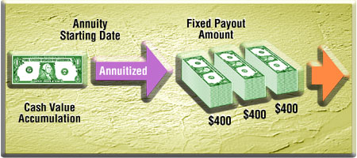
Fixed Annuities
Fully guaranteed contract, which is backed by funds invested in the insurer’s general account
Guaranteed interest can be current rate determined at the beginning of the calendar year or the minimum guaranteed rate that will be paid if the current rate falls below the minimum
Notes:
‹#›
Guaranteed premiums, conservative

Slide 142
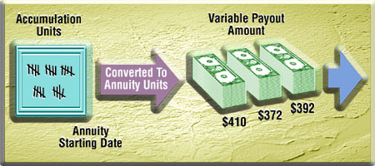
Variable Annuities
Premiums invested in separate account (stocks and bonds)
Value of units and income vary from month to month
Payments tend to trend upward (no guarantee) to overcome inflation
Client bears market risk
Notes:
‹#›
Based on stocks and is more risky, variable=stock market/risky

Slide 143
Annuities Question #2
How are Premiums being paid?
(SP) = Single Premium
(LP) = Level Premium
(FP) = Flexible Premium
Notes:
How are my premiums being paid?
Single premium payment
Lottery, Inheritance, Rollovers (401k)
Level (Fixed)
$500/mo. for so many months
Flexible
Put in what you can when you can
‹#›

Slide 144
Annuities Question #3:
When do payments begin?
Less than 12 months
12 months and 1 day+
Notes:
When do my payments begin?
Immediate Annuity
Now to 12 months
Deferred Annuity
One year and one day
‹#›

Slide 145
Classification of Annuities
Single Premium (SP)
Immediate or Deferred
Single Premium Immediate Annuity (SPIA)
Single Premium Deferred Annuity (SPDA)
Fixed Premium (FP) Deferred only
Fixed Premium Deferred Annuity (FPDA)
Notes:
‹#›

Slide 146
Annuities Question #4
How are benefits paid out?
Settlement options:
Straight Life Annuity or WITH…
…Installment Refund Option-gets payments
…Cash Refund Option
…Period Certain Option
…Joint and Survivor Option
Notes:
‹#›

Slide 147
Settlement Options – Straight Life
Notes:
‹#›

Slide 148
Settlement Options – Installment Refund
Notes:
‹#›
Payments continue after death to the beneficiary

Slide 149
Settlement Options – Cash Refund
Notes:
‹#›
Beneficiary receives all the principal in lump payment after death occurs.

Slide 150
Settlement Options – Period Certain
Notes:
‹#›
15 year annuity: Annuitant dies 11 yrs in, 4 yrs remain

Slide 151
Annuities Question #5
Is more than one life covered?
NO, then it is a standard life annuity
YES, then it is a Joint and Survivor Annuity
Joint and Survivor FULL: the survivor continues to receive the full payment if the one dies
Joint and Survivor ½: gets half payment after 1st death
Joint and Survivor 2/3: gets 2/3 payment after 1st death
Notes:
‹#›

Slide 152
Settlement Options – Joint and Survivor
Notes:
‹#›
Payments continue to the survivor of the both of them, so the annuity payment continues to the survivor until their death!
½ or 2/3 the survivor gets only that much at time of death.

Slide 153
Annuities Question #6
How do I want my annuities taxed?
IRS sees annuities as investments and are going to treat them like investments.
NON-QUALIFIED: Individual Annuity Contracts
(do not have contribution limits)
QUALIFIED: Group employer based
(have contribution limits)
IRAs are penalized for contributing more than $5k/yr
Notes:
We are talking about two different kinds of annuities non-qualified and qualified. CONTRIBUTION LIMITS
‹#›

Slide 154
Nonforfeiture Provisions
Surrender
Only during the accumulation period
Surrender charges (back of policy)
If surrendered before the age of 59 ½ a 10% tax penalty will apply, in addition to the surrender charges
Death Benefit – paid to beneficiary and interest is taxable.
Notes:
‹#›

Slide 155
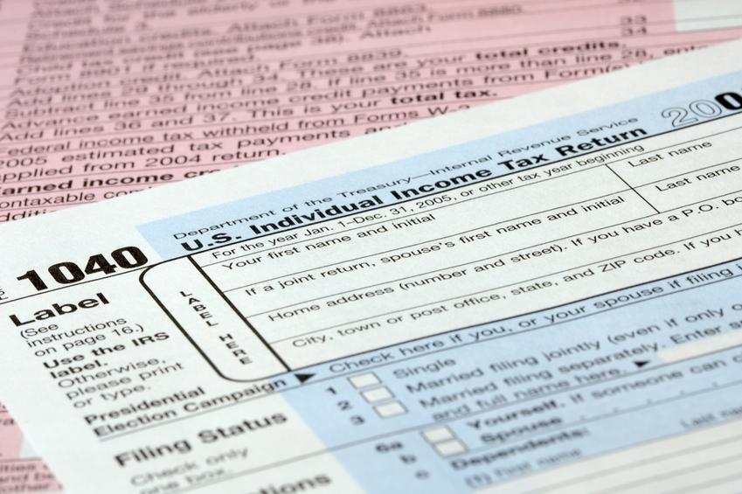
Income Taxation of Deferred Annuities during Accumulation
Annuity earnings grow tax deferred
Partial withdrawals must take out gain before principal (LIFO) –last in first out-
taxed as ordinary income
Early withdrawals (before age 59½) subject to 10% tax penalty
Notes:
‹#›
Deferred though is after 12 months +1 day. So if you withdraw during accumulation the money is taxed on
LIFO: tax on interest first (last in first out)
The money is taxed once you take payments. Last In First Out they tax the interest first. You also have to claim your early withdrawals on your income taxes. You can only take out yourself during the accumulation period. You then are paid in the annuitization period.

Slide 156
Income Taxation on Annuitization Phase
Annuitization payments taxed using exclusion ratio (next slide)
Each payment combines untaxed principal and taxed interest—insurer provides 1099
No tax penalties at any age they are paying out to you
Same rule applies if you surrender with before the age of 59 ½ 10% and interest is taxed immediately
Notes:
‹#›
Accumulation Phase: Tax penalties if you surrender before 59 ½
DURING ANNUITIZATION phase there is no tax penalty.

Slide 157
TAXING OF ANNUITIES Exclusion Ratio
“Pay stub” for annuity contract
Shows how much of each annuity payment is taxable, and how much is excluded from taxation.
Notes:
‹#›

Slide 158
Q&A
21. The primary purpose of an annuity is to
A. liquidate the separate account of an investment portfolio
B. provide income for an individual’s retirement
C. provide income for a beneficiary
D. create an estate immediately
From UNIT 5
Notes:
‹#›
Answer is B

Slide 159
Q&A
22. A retired person purchases an annuity for $90,000. One month later, he starts to receive payments. Based solely on these facts, what type of annuity does he have?
A. Immediate
B. Cash payment
C. Life only
D. Interest-only
From UNIT 5
Notes:
‹#›
Answer is A

Slide 160
Q&A
23. If an annuitant chooses an annuity payout of life with 10 years certain it means that
A. the annuitant must make payments for 10 years.
B. the annuitant will be paid for 10 years only.
C. the annuitant or his survivor is guaranteed 10 years of payments.
D. the annuitant is guaranteed payments for life, but if the annuitant dies before payments have been made 10 years, the beneficiary will receive payments until the end of the 10-year term.
From UNIT 5
Notes:
‹#›
Answer is D

Slide 161
Q&A
24. "Annuity period" refers to which of the following?
A. The time during which payments are made to the annuitant.
B. The time during which premiums are paid to fund the annuity.
C. The process of determining the amount of the annuity payment.
D. The principal factor in determining the annuity premium.
From UNIT 5
Notes:
‹#›
Answer is A
Annuity period=annuitization (income) period

Slide 162
Q&A
25. One major difference between Life insurance and an Annuity is…?
A. Both have beneficiaries.
B. Only Life Insurance has beneficiaries.
C. Only Life Insurance has a death benefit.
D. Both have a death benefit.
From UNIT 5
Notes:
‹#›
Answer is C

Slide 163
Congratulations you have made it through Unit 5! Take a 15 Minute Break
Notes:
‹#›

Slide 164
Unit 6
5 Q’s
Group Life, Business Insurance, Retirement Plans, and Taxation
Notes:
‹#›
Up to this point everything is individual and now it is all group setting insurance.

Slide 165
Group Life Insurance
3 parties (insurer, employer, employee)
Underwriting focuses on group selection criteria and results – not individual
Master policy – held by employer (owner)
Certificate of coverage – provided to employees
“Natural group”; all members are part of a group formed for reasons other than need for insurance
Notes:
‹#›
The policy is between the employer and the insurer.
The group has to have a reason to be a group, a valid group of some reason other than just getting life insurance, someone has to be the EMPLOYER.
Natural group… not just for the sake of getting life insurance.

Slide 166
Contributory vs. Noncontributory Plans
Noncontributory: only employer pays, and 100% of eligible employees are covered
Contributory: both employer and employees pay, and at least 75% of eligible employees must enroll
Notes:
‹#›
Go over slide

Slide 167
Common Group Life Provisions
Grace period
Incontestability
Entire contract
Evidence of insurability
Misstatement of age
Facility of payment
Conversion privilege
Individual certificates
Minimum number of individual members
Notes:
Similar to the individual life insurance policy. If they are paying premiums the grace period is there.
The incontestability clause is there and the insurer has 2 years to correct statements on application other than misstatement of age and sex.
Entire contract that it is all there.
Evidence of insurability, must be proven if employee joins after open enrollment.
Misstatement of age they will go back and change it.
Facility of payment, how the dividends are going to be paid out if there are any.
Conversion privilege, if the group policy is dissolved then the individuals have the right from 31 days of master policy is terminated to get same type of coverage from same company, to convert their policy to individual policy.
Individuals receive the certificates and they have a minimum number of participants, stated in the policy
‹#›

Slide 168
Group Underwriting
Adverse selection
Size of group
Nature of group
Financial stability of group
Number/frequency of new members
Notes:
Underwriting is different from individual.
They are looking at the number of employees not their individual health.
They take into consideration the size of the group and also the financial stability of the group, are they doctors, or are they lawn care people?!
Number of new members.
‹#›

Slide 169
Business Insurance
Key person
Buy-sell agreements
Split-dollar insurance
Notes:
‹#›
Individual Policies put to business use.

Slide 170
Key Person Life Insurance
Protects business against loss due to death of key employee
Business is owner, payor, and beneficiary
Tax treatment
Proceeds not taxable
Premiums not deductible
Notes:
‹#›
If you have vital employees

Slide 171
Buy-Sell Funding
Business continuation where remaining survivors or owners receive a fair cash settlement for a deceased owner’s interest
Death
Retirement
Funding this with life insurance
Types of plans
Entity
Cross-purchase
Tax treatment
Proceeds not taxable
Premiums not deductible
Notes:
‹#›
NEXT SLIDE HAS DIAGRAM…
Contract funded with Life Insurance
A legal contract that can be funded with life insurance products. You have 3 partners.

Slide 172
Buy-Sell Agreement
Sets up a cross purchase or stock redemption plan between all three business owners
$100,000
B
A
$100,000
Business worth $300,000
$100,000
$100,000
$100,000
$100,000
C
Notes:
‹#›

Slide 173
Entity vs. Cross-Purchase Plan
Company purchases policy
Creates new (taxable) assets
Partners purchase policy
Avoids tax problems
Notes:
‹#›
If the entity purchases the insurance than it creates taxable assets. If the partners purchase the policy than it avoids tax problems because it won’t be taxable paid as beneficiaries instead of the company.

Slide 174
Split-Dollar Life Insurance
Key employee borrows part of premium from employer to buy life insurance
Cash value life insurance
Employer owns policy
Employer pays amount equal to CV growth
Recovers outlay from CV or DB assignment
Notes:
‹#›
All you really need to know is that the employer and the employee split the premium and the cash value
Because the owner is the individual you have to know that this is a NON-QUALIFIED plan.

Slide 175
Requirements Common to All Qualified Plans
Must be exclusively for employees and their beneficiaries.
Must be written and communicated to employees.
Must not discriminate.
Must have a vesting requirement.
Must be approved by the IRS
Notes:
‹#›
Now we are going to talk about Qualified plans: We will qualify you if you meet these guidelines:
READ OFF SLIDE:
Vesting: The right an employee gradually acquires by length of service at a company to receive employer-sponsored benefits, such as profit-sharing or a pension. After the vesting period elapses, entitlement to those benefits remains even if employment is subsequently terminated with the company.

Slide 176
QUALIFIED Defined Contribution Plan
separate account for each employee
employer contribution is a stated amount
no promise of any particular benefit
Notes:
‹#›
Like 401k it is a percentage of income, and employers can match it up to 50% not a specified number at the end.

Slide 177
QUALIFIED Defined Benefit Plan
specifies amount of benefits at retirement
does not specify amount employer must contribute
Notes:
‹#›
Direct opposite, will be the fixed amount at end not a certain number of $ going in

Slide 178
Contribution and Withdrawal Penalties
Withdrawal before age 59 ½ is subject to an additional tax penalty of 10% of the amount withdrawn.
Owner reaches age 70 ½ the individual must take a distribution from the account. Failure to do so results in penalty equal to 50% of the amount that should have been taken out.
(IRAs ONLY)
Notes:
SINCE QUALIFIED PLANS ARE DESIGNED AS RETIREMENT PLANS, A TAX PENALTY IS IMPOSED FOR EARLY WITHDRAWALS BY AN INDIVIDUAL.
‹#›

Slide 179
Exceptions to 10% Penalties for Early Withdrawal
Medical expenses > 7.5% of income
Health premiums if unemployed for 12+ weeks
Permanently or totally disabled account holder
College expenses for the account holder or dependent
IRS levy to pay tax debts
Purchase of a first home
Notes:
‹#›
GO OVER SLIDE
THERE ARE FOUR MAIN TYPES OF QUALIFIED PLANS! What are they?

Slide 180
Individual Retirement Annuities (IRAs)
Contributions must be earned income
Contributions tax deductible
Growth tax deferred
Withdrawals taxable
Penalties
Early withdrawal (before age 59½ ): 10% of amount withdrawn
Late withdrawal (after age 70½): 50% of required distribution
Notes:
‹#›
Go over slide

Slide 181
Roth IRAs
Contributions not deductible
Distributions not taxed
Held 5 years and past age 59½
No age 70½ rule
Income limits 5K/yr
Notes:
‹#›
IRS sees the money in there is already taxed, when you take distributions the money taken out is not taxable.
You also don’t have the 70 ½ rule that you don’t have to take it out.
Distributions are tax free
70 ½ rule does not apply
5k per spouse per year

Slide 182
Keogh Plans (HR-10)
For self-employed (sole proprietor)
Tax Deductible contributions by employer only
21-1-1K
Notes:
‹#›
What individual would qualify? Different employers and then a self employed one, need to know who qualifies. Basically need to know WHO can participate in these groups that it is for self employers.
Know 21-1-1k
At least 21
Have to work for company for 1 year minimum
Have to work 1000 hours in 1 year

Slide 183
SEP Simplified Employee Pension Plans
Small employers
Generally IRAs can be 401k’s
SEPs
Employer sets it up for eligible employees and employer contributes on behalf of employee
21-1-1K
Notes:
Self Employee Pension Plans SEPS
Generally IRAs that the employer sets up for the eligible employees. 2111 (twenty one eleven rule) have to be 21 years old, 1 year employment, and 1,000 hours in a year.
‹#›

Slide 184
SIMPLE IRA Savings Incentive Match Plan for Employees IRA
Small employers with less than 100 employees
Generally IRAs can be 401k’s
SIMPLE
Employee and employer contribute
21-1-1K
Notes:
READ SLIDE:
2111 (twenty one eleven rule) have to be 21 years old, 1 year employment, and 1,000 hours in a year.
Savings Incentive Match Plan for Employees SIMPLE for employees with less than 100 employees.
‹#›

Slide 185
401(k) Plans
Most common type of retirement plan
Any types of employers with more than 100 employees
Deductible contributions by employees matched by employers
Notes:
‹#›
401k is the code the IRS gave it. For large groups.
READ SLIDE

Slide 186
Tax-Sheltered Annuities (TSAs)/403(b)
Employees of schools, public hospitals etc
$ withheld to purchase annuity for employees retirement
Deductible contributions by employees
Taxed at payment
Salary reduction
Notes:
‹#›
Profit Sharing Plans contributions are made only if the company has profits
TSAs
Reduce your salary and invest tax deferred, up to $15,000

Slide 187
Non Qualified Plans
Benefit executives and highly paid employees (key employees)
Employer may choose which employees to cover (can discriminate)
No tax advantages = after-tax contributions
Qualifed = qualify for certain tax benefits set by federal guidelines
Examples: executive bonuses, individual annuities and split dollar
Notes:
Differences between qualified and non qualified plans: READ OFF SLIDE!
1035 exchange read over we aren’t going to cover it.
‹#›

Slide 188
Taxation of Life Insurance
Premium payments
Individuals—after tax
Business plans—after tax
Group—deducted
Exception for over $50K
Proceeds—tax free
CV surrender—excess over premiums paid is taxable
Dividends—tax free
Notes:
‹#›
Premium payments are generally not deductable except in group
Death benefits (proceeds) are tax free

Slide 189
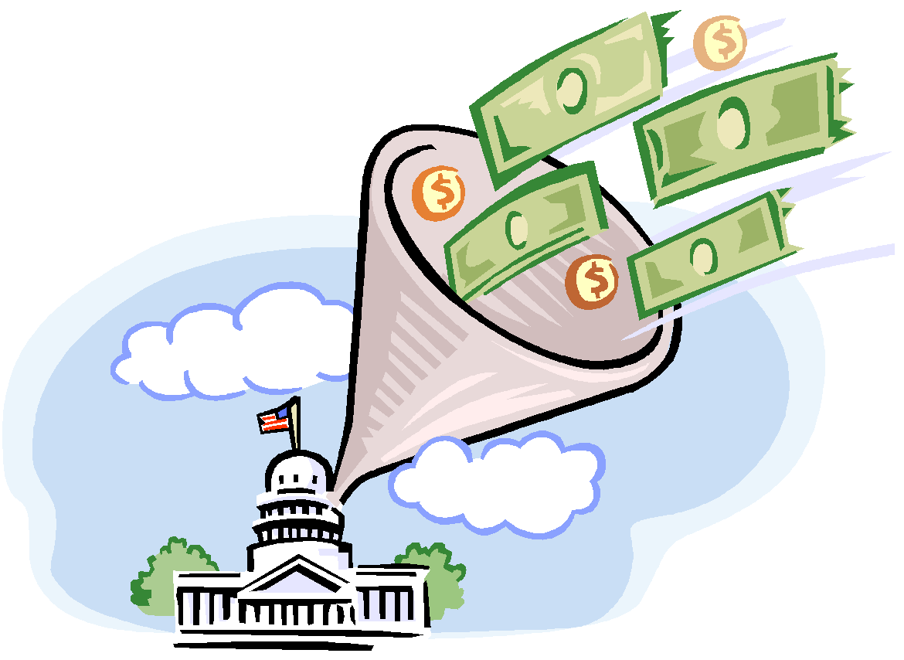
Taxation of Qualified Retirement Plans OVER VIEW
Employer contributions
deductible business expense
not taxable to the employee when contributed
taxable to the employee when paid as a benefit
Earnings exempt from income tax
Accumulated values grow tax-deferred
Employee contributions are generally deductible
Notes:
‹#›
Tax deductable
Tax Free – IRS can’t touch it
Taxable Benefits

Slide 190
Q&A
26. An agreement to purchase a deceased partner’s share of a business which is usually funded by life insurance best describes a:
A. Keogh plan
B. split-dollar plan
C. buy sell agreement
D. key-employee life insurance
From UNIT 6
Notes:
‹#›
Answer is C
Buy sell agreement definition

Slide 191
Q&A
27. When a firm establishes a contributory group term life insurance contract, what percentage test must be met for the participation?
A. 50%
B. 60%
C. 75%
D. 100%
From UNIT 6
Notes:
‹#›
Answer is C

Slide 192
Q&A
28. Under a group life insurance policy, an employee demonstrates evidence of participation by producing a:
A. master policy
B. certificate of insurance
C. group policy
D. premium receipt
From UNIT 6
Notes:
‹#›
Answer is B

Slide 193
Q&A
29. The penalty for early withdrawals from an IRA or other qualified retirement plan before age 59 ½ is
A. 20% of the amount withdrawn.
B. 12% of the amount withdrawn.
C. 10% of the amount withdrawn.
D. 6% of the amount withdrawn.
From UNIT 6
Notes:
‹#›
Answer is C

Slide 194
Q&A
30. A Keogh (HR-10) plan would be appropriate for which of the following?
A. a closely held corporation
B. a hospital
C. a school
D. a self-employed person and his/her employees
From UNIT 6
Notes:
‹#›
Answer is D

Slide 195
Unit 7
5 Q’s
Utah Life, Accident and Health Insurance Law
Notes:
‹#›

Slide 196
Agent/Broker Licensing
At least 18 years of age
Resident of Utah
Complete application/pay fee
Pass the license examination
Be of good character
Submit to a background check
Notes:
‹#›
If you want to be a licensed agent in the State of Utah… read off slide.
This slide states what it takes to apply for a license in the state of UTAH.

Slide 197
Continuing Education (CE)
Licenses do not expire if CE is completed and renewal fees are paid
CE requirements
24 hours every 2 years
3 hours of ethics
50% classroom
No carryover
24 hrs
Notes:
‹#›
Only one resident license
24 hours of CE! Have to do every two years.

Slide 198
License Suspension, Revocation, Refusal to Renew…
Violating a statute, rule, or order in Utah or another state
Is insolvent
Has failed to pay a final judgment
Unfair claims settlement practices
Assisting unlicensed transactions
Refuse to cooperate with an examination
Lying on the license application
Attempting to obtain the license through misrepresentation or fraud
Misappropriation or converting to ones own use money required to be held in a fiduciary capacity
Notes:
‹#›
What happens if you violate your rights.

Slide 199
License Suspension, Revocation, Refusal to Renew
Material misrepresentation of the terms of any insurance contract.
Conviction a felony
Committed an unfair trade practice or fraud
Unqualified, incompetent, or financially untrustworthy
Forged documents in an insurance transaction
Cheated on a license exam
Not paid child support or income tax
Engaged in violent crimes
Endangers legitimate interests of customers and the public
Change address within 30 days
Notes:
‹#›

Slide 200
Commissioner of Insurance
Appointed to four-year term
Broad Powers
Enforce Utah Insurance Code
Make reasonable rules and regulations to administer the Code
Conduct investigations and examination
Hold public meetings
Issue annual report
Notes:
‹#›
If you change your address you have 30 days to change it on your license. COMMISSIONER is very testable.

Slide 201
Unfair Claim Settlement Practices
Knowingly misrepresenting facts or policy provisions
Attempting to settle a claim based on alterations to the application made without the insured’s knowledge
Not attempting in good faith to settle when liability is clear
Notes:
‹#›

Slide 202
Unfair Claim Settlement Practices (cont’d)
Issuing checks in partial settlement under coverage that releases total liability
Advising insured's to not hire an attorney
Misleading a claimant about statutes of limitations
Refusing to provide a written justification for claims denial upon request
Failing to reimburse expenses and interest caused by delayed claims payments
Notes:
‹#›

Slide 203
Unfair Trade Practices
Misrepresentation—lying
False Advertising
Rebating
Unfair Discrimination
Boycott/Coercion/Intimidation
Illegal inducement
Notes:
‹#›
MISREPRESENTATION is lying to get business
ILLEGAL INDUCEMENT giving away things for business, can’t gift over $3
REBATING discounting premiums if you sign up after it’s been established.
UNFAIR DISCRIMINATING you can’t tell them that you are special and I can get you a deal
BOYCOTT can’t threaten people
False Advertising

Slide 204
Examination of Records
Commissioner may examine an insurer’s transactions, accounts, records, documents, assets at any time
Licensed producers and applicants may also be examined
Insurers holding a domestic or nondomestic Certificate of Authority must be examined at least every 5 years
Notes:
‹#›
The commissioner has to examine every 5 years.

Slide 205
Fraud
Making false statements regarding a claim
Benefitting from the proceeds of an insurance fraud
Failing to forward premiums
Assisting anyone else in committing fraud
Supplying fraudulent information to the insurance department
Notes:
‹#›

Slide 206
Q&A
31. How many hours of continuing education must be completed every two-year period?
12 hours
16 hours, including 3 in ethics
20 hours
24 hours, including 3 in ethics
From UNIT 7
Notes:
Answer is D
‹#›

Slide 207
Q&A
32. The document that contains information on determining the type and amount of life insurance to purchase is called a
Buyer’s Guide
Policy Illustration
Policy Summary
Table of Projected Value
From UNIT 7
Notes:
Answer is A
‹#›

Slide 208
Q&A
33. All of the following are covered under replacement regulations EXCEPT
Term life insurance
Whole life insurance
Credit life insurance
Universal life insurance
From UNIT 7
Notes:
Answer is C
‹#›

Slide 209
Q&A
34. All of the following are true about HIV testing EXCEPT
Questions cannot be directed towards determining sexual orientation
Sexual orientation can be used to determine insurability
Blood tests used to detect HIV cannot be administered unfairly
Applicants must sign a written release form for HIV testing
From UNIT 7
Notes:
Answer is B
Cannot discriminate
‹#›

Slide 210
Q&A
35. The Utah Insurance Commissioner is
Elected by the people of Utah
Chosen by the state legislature to serve for life
Appointed by the Governor for a four year term
Appointed by the Attorney General for a four year term
From UNIT 7
Notes:
Answer is C
‹#›

Slide 211
Unit 8
5 Q’s
ETHICS
What is Ethics?
Notes:
‹#›

Slide 212
WHAT IS ETHICS?
Derived from the Greek words - ethikos and ethos meaning "moral" and "character".
Closely associated with "the law" but key differences.
Several views of ethics and ethical behavior have evolved.
Tied closely with personal belief systems.
Notes:
We will start from general terms of ethics and then get more specific through the course. First of all, lets look at the word "ethics". It is derived from the terms ethikos and ethos, which are Greek terms for moral and for character. Another issue we will come across is the issue of ethics and the law. What are the differences between acting ethically and acting lawfully? There are different views on that topic. What we will also do is break down what various practitioners and thinkers have thought about ethics and what constitutes ethical behavior. We will then divide them into several schools of thought. Finally, we will talk about how, although ethics is not an absolute personal belief system, it is going to have a major role on what ethics is for any individual.
‹#›

Slide 213
WHAT IS ETHICS?
Golden rule
Being good
Spiritual cleanliness
Favor the group or family over one's self
Reach for the ideal path
Notes:
A good place to start talking about ethics is our youth. When we were growing up, our parents, grandparents and others whom we respected told us that we should act a certain way. I think we pass this on to our children as well. Sometimes we don't think about it but, in essence, it is a good place to start. We are basically training our children to be ethical. So what are some of the things we say? Well, there is the golden rule: Do unto others as we want done unto us. That is a reasonable way to evaluate situations that may arise in the business world as well. Another thing we are told is to be good and not to be bad. Striving for goodness historically has been the cornerstone of what ethics is all about. Our spiritual cleanliness has certain religious connotations. You can also look at it in terms of sleeping at night - if you are to do something, one of the things you might want to think about is if there is any ethical dilemma involved, "is this something that will keep me up all night or will it not be a problem?"
Another issue in ethics is fairness. When we talk to our children we usually tell them that they should be fair, that other people are people too, that when there is a group you work together, that they shouldn't be selfish. These are key issues in the business world as well. What many of us try to do is instill in our kids a feeling of what is it that we are striving for, what it is that we want in life, what will make us happy, finding an ideal path. We may not reach it, but it gives us some direction and something to pursue.
‹#›

Slide 214
CLASSIC ETHICS
Aristotle
Plato and Socrates
Max Weber
Confucius
John Stuart Mill
Notes:
Let's look at some of the classic ethics literature and some of the classic thinkers in this area of ethics. We start with Aristotle who, for thousands of years, was considered the cornerstone thinker in this area. He had a couple of basic ideas about ethics. One is that that ethics is acquired by habit. That what we should do we do over and over and over again so that it becomes engrained. He didn't necessarily feel that ethics was something you were born with-it was acquired by habit. But why would you want to develop that habit and then start over? He said in his writings that in order to be truly happy, you have to be ethical. Happiness and ethical behavior also appear in many other writings. Another issue that Aristotle talked about was the Golden Mean. What he meant by that was when you are faced with a particular dilemma, there are usually extreme behaviors, extreme choices. Aristotle felt that 99% of the time the best course of action was somewhere in the middle. That is called the Golden Mean.
Next is Plato, who actually came before Aristotle. He wrote dialogues about himself and his teacher Socrates. He wasn't as specific as Aristotle when he talked about ethics. What he used was called the Socratic Method which was just going back and forth through questions and answers between Socrates and his students. One thing that Plato stressed in many of his dialogues is that virtue is said to be harmonious. You need ethics to be virtuous and that is the only way to truly be happy.
Max Weber was an early writer from the Capitalist system and he saw ethics from a slightly different perspective. He thought that ethics was something that was necessary for society in order to hold the capitalist system together. If there isn't a set of ethics that people adhere to, anarchy would ensue and the whole system would fall apart. Therefore, from a societal point of view, he felt that ethics was critical.
Confucius gives us a good example of Eastern thought on ethics. One thing that resonates in many of his, and many other Buddhist and Eastern writings, is that there exists a whole rather than many parts. In the western world we like to break things down into specialized pieces and departments, whereas Confucius saw everything as a whole. In order to be happy you had to be a part of that whole and had to strive for an ideal path along which walked a superior man. Working together and ethics were harmonious keys to reaching that goal.
John Stuart Mill was another key thinker in this area. He looked at ethics as doing what does the greatest amount of good for the greatest amount of people. That is called the Utilitarian view, which we will cover in more detail in the next section.
‹#›

Slide 215
WHAT IS ETHICS?
Utilitarian - do what delivers the greatest good to the greatest number of people.
Individualism - do what serves the best long term interests of the individual.
Moral-rights - always respect human rights first.
Justice - do what is fair and equal to all those involved.
Relativism - do what is accepted in the society or group in which you work.
Notes:
There are mainly five views of ethical behavior. If you take any situation involving an ethical dilemma, you can look at it from any of these five different perspectives. Each one gives you some insight as to which course of action is best.
The first one is the offshoot of John Mill's views - Utilitarianism, which is doing the greatest amount of good for the greatest number of people. He even had a measurement for it-he called it hedons. Therefore, you try to generate as much hedons as possible.
The second one is Individualism, which is partly associated with the United States' Constitution and The Bill of Rights and is generally used in this country. Individualism means doing what is best for the individual over the long term. Usually that is going to involve a high ethical standard. If you change long term to short term it would probably mean a very low ethical standard. Long term business relationships and long term relationships in general, need a solid, trusting base.
The third would be moral rights, which has probably blossomed mainly from religious views. This means that there is a certain code that you must follow and there is no deviating from that. There is no relativism, or movement. Religious texts, such as The Ten Commandments, say what is to be done and not to be done.
The fourth one is a justice view, which also stems from the American view of the world. This means doing the fairest thing and treating everybody as an equal in court. Let's try to be as just as we can.
The fifth view would be as we discussed briefly before-Relativism. Sometimes it is very hard to know how to conduct yourself in a business situation outside of your normal society or your normal circle of customers. With this, companies should act in a way that is acceptable in the foreign countries in which they do business.
‹#›

Slide 216
Ethics… not a science
Gray areas are often difficult to solve
Personal belief systems vary
Corporate cultures vary
National cultures, rules and laws are unique
Notes:
Ethics is obviously not a cut and dried issue and there is no ethical formula based on discipline. It certainly is not a science. There are many gray areas in ethics, which makes ethical problems very difficult to solve. It will usually require a tradeoff between economic well-being and moral attitude-doing what is right. It is not going to be completely clear in every situation which course is best. So we have to have some guidelines. People are going to generate their own personal belief systems and that will be an important part of the decision-making process. We are also going to take into account your company's views on what is acceptable behavior and what is not acceptable behavior. This may not have to do with ethics- it may have to do with formalities, certain traditions and customs. These will all have an effect on how you handle certain situations. Also, the country in which you live, the state and the laws are all going to impact you. None of these on their own would be enough to help you decide exactly what to do. Of course, what you need to do should be legal, but beyond that, everything is going to have to be taken into account.
‹#›

Slide 217
Ethics… a balancing act…
Profits balanced against ethics
Insurer and policyholder
Beating the competition vs. proper representation
Notes:
What results is a balancing act. There is a symbol from the Tao's tradition called yin-yang that shows two forces in inextricable conflict with each other, one is pushing and the other one is pushing back. Tao felt that that is what life is about-balancing the yin and the yang, balancing economics vs. family vs. morality vs. ethical conduct vs. peer pressure. We also have to balance profits vs. ethics- i.e. the insurers needs vs. the policy holders needs and beating the competition vs. being somebody who works within an industry and tries to represent it in the best way possible.
‹#›

Slide 218
Q&A
36. The word ETHICS originates from which language?
English
Romanian
French
Greek
Notes:
Answer: D
‹#›

Slide 219
Q&A
37. Which is NOT one of the five main views of ethical behavior?
Individualism
Justice
Relativism
Environmentalism
Notes:
Answer: D
‹#›

Slide 220
Q&A
38. Aristotle’s theory that Ethics is acquired by habit is known as?
Golden Mean
Socratic Method
Utilitarian View
Aristotle’s View
Notes:
Answer: A
‹#›

Slide 221
Q&A
39. What is the definition of Relativism?
Do what serves the best long term interests of the individual
Do what is accepted in the society or group in which you work
Always respect human rights first
Do what delivers the greatest good to the greatest number of people
Notes:
Answer: B
‹#›

Slide 222
Q&A
40. What is the definition of Utilitarianism?
Do what serves the best long term interests of the individual
Do what is accepted in the society or group in which you work
Always respect human rights first
Do what delivers the greatest good to the greatest number of people
Notes:
Answer: A
‹#›

Slide 223
Unit 9
5 Q’s
ETHICS
The Agent Responsibilities and the Law
Notes:
‹#›

Slide 224
Insurance Law
Paul v. Virginia (1868) indicated regulation by the states
US v. Southeastern Underwriters (1944) deemed insurance an interstate trade that falls under federal law
McCarran-Ferguson Act (1945) reserved the federal right to regulate in the cases of fair labor standards and antitrust. All other regulations were reserved for the states.
Notes:
Let's do a brief history of insurance law in the United States in order to get a perspective. The first insurance law was passed in 1868. It stemmed from the Paul v. Virginia case that ruled that the states were allowed to individually regulate insurance agencies. In 1944 a landmark decision in US v. Southeastern Underwriters deemed that insurance is classified as interstate trade and that it falls under federal law, which meant that federal law would apply. This caused quite a bit of confusion until the McCarran-Ferguson Act in 1945 deemed that the US government reserved the right to regulate in cases involving primarily fair labor standards and antitrust. Federal government regulates all industry in this area. All other regulations are reserved for the states. So each individual state basically creates and implements its own laws relative to the insurance industry and the insurance agent.
‹#›

Slide 225
Individual States and NAIC
Creates recommendations and model laws for states
Tries to encourage uniformity
Assist officials in administration
Protect the interests of the policyholders
Preserve state regulation
Notes:
Now there is a very important organization that we have discussed previously in this course called the National Association of Insurance Commissioners (NAIC). As mentioned, one of the primary functions of this organization is to create model laws. We discussed one of the model laws earlier when we discussed marketing. Let's look at it in a little more detail. The NAIC is an organization in which all insurance commissioners are automatically members and they work to put together model laws, which they bring to the states as ways that the state should consider regulating their insurance agencies. The first thing they try to accomplish is uniformity of the law-if all the states had a wide variation in law, companies that are doing business in more than one state would be unfairly fettered. Secondly, they try to assist officials in administering laws and regulations. Thirdly they help to protect the interests of the policyholders through putting together laws that look at particular issues that are most important to the needs of the policyholder. And finally the NAIC exists to preserve state regulations.
‹#›

Slide 226
Representations
Only state licensed insurers may issue policies
Any written or oral statement that misrepresents a policy's features is illegal.
Defaming a competing agent or insurance company by spreading unfounded rumors or falsehoods about Integrity or financial condition is illegal.
Notes:
The ethics of marketing is a particularly large area of concern for states relative to the regulations of insurance industries. Most states are fairly uniform in their regulation of marketing ethics issues. Some of the key issues that are addressed in statutes are, first of all, only state licensed insurers may issue policies-there is a process and everyone is expected to do that to go to the state commissioner's office and be licensed. Secondly, any oral or written statements that involve misrepresentation of a policy and its features are illegal. Thirdly, defaming a competing agent or insurance company by spreading unfounded rumors or falsehoods about integrity or financial condition in order to take advantage of a particular market is illegal.
‹#›

Slide 227
Rebating
Giving a buyer a portion of initial premium back as an inducement to buy.
Can be in the form of money, a product or a service.
Is Illegal!
Notes:
Another area of concern among insurance commissioners is the practice of rebating. Rebating can be defined as giving a buyer a portion of the initial premium that was originally going to the insurance agent back to the consumer as an inducement to buy a particular policy. It can take the form of money, of additional product or of service, or anything of value that is returned back to the policyholder in exchange for signing into a particular policy. Rebating for the most part is considered an illegal activity. There are some exceptions that some states have put in place, but the vast majority of state laws outlaw rebating.
‹#›

Slide 228
Twisting or Churning
Twisting is the attempt to persuade a policyholder to drop coverage in order to sell them new coverage to the material disadvantage of the customer.
Churning is the practice of using a policy value to purchase another policy with the same insurer for the purpose of generating additional premiums and commissions.
Notes:
Two other activities that are commonly referred to in insurance law at the state level are usually associated with a couple of descriptive names-one is twisting and the other is churning. Both practices are illegal in all states. Twisting is an attempt to persuade a policyholder to drop a particular policy in order to take on a new policy for the primary reason of gaining commissions for the insurance agent. Churning, which is similar, is the practice of using a policy value to purchase another policy with the same insurer-again just for the purpose of getting additional premiums and commissions. Basically it is the act of ignoring the customer's needs and telling them that the policy they have isn't appropriate for them regardless of whether it is or not, getting them to drop it and then selling them a new policy. These practices are unethical and illegal.
‹#›

Slide 229
Replacement
Replacement is the practice of convincing a consumer to let a policy lapse and purchase another.
Replacement is usually not in the client's best interest and is illegal in those cases.
When it is beneficial, an agent should inform the consumer fully about the new and old policy and what Features will be affected.
Notes:
Replacement is another area of concern. There are situations where this practice makes sense, but in many cases it is considered unethical and in some cases, illegal. Now how would you know if a particular case of replacement is illegal or not? Well, let's go through some issues. First, defining replacement-a practice of convincing a consumer to let a policy lapse and then to sell them another one. On the surface it sounds like twisting and churning but in actuality it is not because many insurance policies no longer meet the particular needs of individuals. Therefore, it is to their advantage to let it lapse, which is the major difference in whether or not replacement is appropriate. As long as the practice is being conducted with the primary purpose of meeting the needs of the client, not the agent, replacement would be appropriate. However, replacement is usually not in the client's best interest and would then be an illegal practice. When it is beneficial, the insurance agent should inform the consumer fully about the new and old policy; how the features are going to be affected and how his coverage will be affected. An example of replacement that would make sense is a case where somebody bought a whole life insurance policy when they were very young then fifteen years later, they are employed, married, and have children and want to switch to a larger term policy. Replacement would certainly be an acceptable practice in such a case.
‹#›

Slide 230
Solicitation and Disclosure
Use disclosure documents when soliciting an insurance sale.
Use Buyer's Guide and Policy Summary
Notes:
We will now look at solicitation and disclosure. It's possibly the most critical area of the insurance agent's relationship with the general public. There have been certain laws and certain ethical guidelines that have been put in place some of which involve the relationship with the community. The first thing you might want to look at is something called the Buyer's Guide and Policy Summary. It gives an overview of ways to make your message heard in an ethical way. Not only will this help you understand what is required, but it will also serve as an excellent tool to make the case for insurance sales in general.
‹#›

Slide 231
License Suspension
Making a material untrue statement in an application for an agent's license.
Stating or implying that a policy is "self-supporting" (no additional payments req).
Implying that a policy is being issued by the investment dept. of an insurance co.
Conveying the idea that a consumer will receive special treatment
Notes:
If you perform acts that are considered unethical in the eyes of the law, the most common penalty will be license suspension. Now we will discuss a number of acts that in most cases are going to lead to license suspension. First of all making a materially untrue statement in an application for an agent's license would be one of the first steps to license suspension. In fact it would be more the case for license denial. The second would be stating or implying that a policy is "self-supporting". That relates to what we talked about earlier with using the terms vanishing premiums or saying policy premiums will vanish or no additional payments are required are grounds for license suspension. Thirdly implying that a policy is being issued by an investment department of an insurance company-again, this comes back to the untrue statement issue. Policies need to be explained as to exactly where they come from relative to the insurance company issuing the policy. Conveying the idea that a consumer will receive unusual special treatment-most laws that are put on the books relative to policy try to promote uniformity in features and benefits for all consumers of a particular product.
‹#›

Slide 232
License Suspension
Describing the premium as a "deposit" unless the payment establishes a debtor/ creditor relationship and allows withdrawal
Indicating that future policy dividends are guaranteed
Stating the insured will be guaranteed certain benefits should a policy lapse without explaining non-forfeiture benefits
Notes:
Describing the premium as a "deposit" would be illegal and grounds for license suspension unless the payment establishes some type of debtor/creditor relationship, which is what a deposit is by law, and allows for withdrawal. Indicating that future policy dividends are guaranteed-again that relates to computer projections, is also grounds for license suspension. Furthermore, the agent must ensure that what is assumed and what is not guaranteed is explained clearly. Another act that would result in license suspension is stating that the insured will be guaranteed certain benefits even if a policy lapses without explaining what non-forfeiture benefits are-again this relates to explaining specific insurance terms that most lay people are not going to understand.
‹#›

Slide 233
License Suspension
Stating the policy has certain benefits not found in any other insurance contract
Stating the prospect must purchase the policy immediately or will lose the opportunity to purchase it
Not clearly stating that insurance is the product that is being solicited
Notes:
Stating the policy has certain benefits not found in other products again would come into the area of untruth and most likely lead to license suspension. High pressure sales tactics such as stating the prospect must purchase the policy immediately is not allowed. Also not clearly stating that insurance is not the product that you are going to sell by trying to make it seem you are selling something else or giving something away and then trying to sell insurance is illegal and grounds for license suspension.
‹#›

Slide 234
License Suspension
Describing oneself as a "financial planner", "financial consultant", "investment advisor", or a similar term that implies that that the agent is in the advisory business in which compensation is unrelated to sales unless such is actually the case.
Using amounts, numbers and projections (w/o time value of money) that mislead.
Notes:
Another one is representing yourself as more than you actually are, such as describing yourself as a financial planner, financial consultant, investment advisor, or any term that implies that you are a financial advisory business person. So if you only sell insurance then using these other terms and to go into these other businesses is grounds for license suspension. The next one is similar to one we mentioned earlier, which is using amounts, numbers, and projections that mislead-probably the number one area of concern among insurance commissioners and the general public.
‹#›

Slide 235
Insurance Agent vs. Finance Planner
Must sell a variety of financial products and services.
Educated in the field.
CFP and ChFC are the most recognized designations.
ICFP and IAFP are organizations that can provide guidance.
Notes:
Now that leads us into the next area, financial planning. Financial planning and insurance are very closely related services and often go hand in hand. But there are a number of issues revolving around financial planning that need to be kept in mind and separated from the insurance business. First of all, in order to claim that you are a financial planner, you must sell a variety of financial products and services. It is not always illegal to say you are a financial planner when you only sell insurance but it is certainly very unethical. You should certainly have an education in the field-there are a number of designations, which are considered appropriate for a person who calls himself a financial planner. CFP and ChFC are the most recognized designations. ICFP and IAFP are organizations that can help or provide guidance in telling you how you can get designations, what degrees would be most appropriate.
‹#›

Slide 236
Financial Planning…
An insurance agent must accept a broader range of ethical responsibility if expansion into financial planning is undertaken.
If a fee rather than a commission is charged, you are deemed a fiduciary of the client.
Conflicts of interest can occur due to an agent's status as a fiduciary with an insurer.
Full disclosure is critical.
Notes:
In financial planning, since you become much more involved in very confidential financial issues with customers, you accept an even broader range of responsibility vs. just being on the insurance end. If a fee rather than a commission is charged, you are deemed a fiduciary of the client. And as we mentioned earlier, you are not a fiduciary of the client when you are just an agent. But when you get into the financial planning, investments and trusts businesses, you are by law a fiduciary. And conflicts of interest can occur due to an agent's status as a fiduciary with an insurer as well. So you are a fiduciary with an insurance company at the same time as you are a fiduciary with a client-it can be a very difficult situation and needs to be thought out very carefully and clearly. One way to get around it is to make sure that you have absolute full disclosure of your situation to both parties in the most complete manner possible.
‹#›

Slide 237
Investment advice
Under SEC jurisdiction.
If a fee is charged for investment advice:
Register as an investment advisor with the SEC.
Conform to ethical guidelines defined in the act.
Notes:
There are a number of laws that have been put on the books relative to investment advisors. The Advisors Act of 1940 was one of the most important ones. It makes the financial planning business under SEC jurisdiction. If a fee is charged for investment advice then you are required to do two key things. One is to register as an investment advisor with the SEC and the second is to conform to very strict ethical guidelines defined in the act.
‹#›

Slide 238
The Law and Ethics
Laws provide a minimum standard.
Personal standards must be higher.
Self satisfaction or Plato's "Happiness".
Build integrity and credibility.
Long run it will be the most beneficial path.
Notes:
As we are reviewing the laws and trying to understand how they fit with ethics, it is important to point out that the law provides the minimum standard. If you follow the laws of your state you are being ethical to a very minimal level. You are also going to have certain personal standards and they must be higher than what the law says you have to do. Why? You may go back to the first few slides in module 1 where we talked about what leads to happiness and self-satisfaction. That would be the number one reason. If you act in a highly ethical manner in all your dealings, you are going to feel very comfortable about the quality and professionalism of your work, and you won't have to worry about anything that could destroy your reputation. You can feel assured that you have always done the right thing to the best of your ability in all cases. This has certain key advantages relative to doing business. If you have a very high level of ethical standards people are going to know that. In time, word will get around that you are someone with high integrity, someone very credible, someone to work with because your product involves a high degree of professionalism and trust. It is obviously the way to build a business and to be a beneficial part of the society in which you work.
‹#›

Slide 239
Agents Responsibility to the Company
Legal term describing relationship between 2 parties -- the principal and the agent
Contractual agreement
Agent "is" the principle
Payments made to agent are the same as if made directly to the principle
Knowledge is shared
Notes:
First of all, let's try to define what is meant by the term agency. It is a legal term that describes the relationship between individuals, between organizations, or between individuals and organizations in which the agent represents the principal in relationships where contract or agent contract exist. Whatever the agent does, it is as if the principal does it. It is representation in its purest form. A key example of that happens in the insurance industry when payments are collected. We will be discussing this more as we go through this module. A payment made to an agent would be the same as if the payment were made directly to the principal. Knowledge is also passed from the principle to the person or organization represented. For example, information about an applicant would be shared completely. Again, the agent in essence is the principal.
‹#›

Slide 240
Authority and Power
Granted through agency contract
Authority is scope and delineation of territory
Power involves actions allowed by the insurer
Three types of Agency Authority (next slide)
Notes:
There are two key aspects to agency: authority and power. Although these terms are used interchangeably, they have specific individual definitions. Power is what an agent could legally do. Forming agreements, signing policyholders, taking applications and paying premiums all involve power. Authority comes into play in terms of scope. A particular power could be limited to a particular region then authority is in a particular region. The particulars of authority will be delineated in the agent contract. So power involves the actions that are allowed by the insurer and those should be specified quite clearly.
‹#›

Slide 241
AUTHORITY
Express Authority - written or oral authorization
Implied Authority - assumed authority to conduct business
Apparent Authority - gained through appearance and tacit approval
Notes:
Authority can be divided into three classifications: express authority, implied authority, and apparent authority. These types are related to the degree in which the authority is spelled out in the contract or is inferred by implication or general practice. Express authority would be clearly written in the contract-these are the things that are authorized in writing, which is often better than an oral contract. Implied authority is authority that is assumed but not explicitly written. Examples of implied authority include signing policyholders and collecting the initial premiums. Apparent authority is what the insurer normally allows. For example, if an agent agreement with an insurer authorizes the applications only within a specified geographic area but the company then accepts applications outside that area, there is apparent authority to do so.
‹#›

Slide 242
Fiduciary responsibility
High ethical standards
Involves trust and confidence
Transacting business in the name of others
Collecting and managing money for others
Notes:
Another key issue related to the agency is what we call a fiduciary responsibility. The term fiduciary coincides with very high ethical standards. It means that you are involved in situations in which you are going to be responsible for handling a person's money. For example, a trust officer has the fiduciary responsibility to handle the money of an individual and to abide by their wishes until they are deceased. Fiduciary responsibility is a key element in that particular occupation. The same fiduciary responsibility exists for the insurance agent relative to the insurer. The agent collects money for the insurer, who may not know when the money is actually collected. When money is accepted by a fiduciary, there is a responsibility to keep good records and to transfer that money as promptly as possible.
‹#›

Slide 243
Fiduciary Responsibility
Loyalty to insurer (no conflicting representation relationships)
Care and skill in carrying out business for the insurer
Full disclosure of information regarding application and claims-handling
Notes:
There are three requirements for fiduciary responsibility. First of all, there must be a very strong loyalty to the insurer, without any conflicting representative relationships with other insurers in the exact same area. Great care and skill must be taken in carrying out business for the insurer and all information must be transferred and claims handled in the highest ethical manner.
‹#›

Slide 244
Fiduciary Responsibility
Prompt action and follow-up regarding the collection of premiums and paperwork
Payments to agent are, by law, the same as payments to the insurer. Delay or withholding
payments from insurer is unethical (illegal in some states)
Keep insurer and agent money separate
Notes:
Another major fiduciary responsibility for an agent is collecting premiums. Prompt handling of paperwork and transferring of monies is of great importance. When you receive the payment, you are in a sense, the insurer receiving the payment. Any lag time between the time that the policyholder pays for that policy and the time that it goes to the insurer, is your responsibility, so it makes sense to get past that as fast as possible. And when you do have that money for that in-between period, you are responsible to keep that money in a separate account. There should be no mixing of monies between the agency's money and the money that goes directly to the insurer.
‹#›

Slide 245
Agent Responsibility
Best possible risk for insurer.
Exercise reasonable care.
Submit all applications even if little chance of approval.
Let insurer's underwriter make acceptance decisions.
Notes:
Another key area involving the insurer and the agent has to do with the soliciting of business. It is highly important that you look for the best possible risks for the insurer -in other words, if you were the insurance company, whom would you want to insure? The agent takes that into account by exercising reasonable care when accepting applications. You have to be as forthright as possible in the transfer of knowledge as we discussed earlier. As part of the fiduciary responsibility, all applications have to be submitted, even if there is little chance of approval. It is up to the underwriters to decide whether this is a risk worth taking. All the knowledge that an agent has in a particular matter needs to be communicated to the insurer.
‹#›

Slide 246
Q&A
41. What organization helps to protect the interests of the policyholders through putting together laws that look at particular issues that are most important to the needs of the policyholder?
CIA
IRS
NAIC
MIB
Notes:
Answer: C
‹#›

Slide 247
Q&A
42. Giving a buyer a portion of initial premium back as an inducement to buy is an example of?
Rebating
Replacement
Cheating
Giving away
Notes:
Answer: A
‹#›

Slide 248
Q&A
43. The practice of using a policy value to purchase another policy with the same insurer is called?
Twisting
Circling
Churning
Wrenching
Notes:
Answer: C
‹#›

Slide 249
Q&A
44. The attempt to persuade a policyholder to drop coverage in order to sell them new coverage to the material disadvantage of the customer is called?
Channeling
Churning
Flipping
Twisting
Notes:
Answer: D
‹#›

Slide 250
Q&A
45. The practice of convincing a consumer to let a policy lapse and purchase another is known as?
Twisting
Churning
Replacing
Reinstatement
Notes:
Answer: C
‹#›

Slide 251
Unit 10
5 Q’s
ETHICS
Insurance Agent and the Client
Notes:
‹#›

Slide 252
The Agent and Client
Carefully analyze a customer's situation
Do not hide or withhold general information
Do not benefit from unreasonable fears or lack of insurance knowledge
Notes:
One of the most obvious issues facing an agent is that they need to sell the proper amount and type of insurance to meet the needs of the customer. Selling too little to the customer is detrimental to the customer's interest and selling too much to the customer will cause ethical difficulties down the road. It is important to always try to pinpoint the needs of a particular customer and then see what product best matches it. How do you do that? Well first you want to talk to the customer and carefully analyze the situation and what the customer says he/she wants to result from a particular policy. After which you would explain the various products that you represent and in your own mind try to think of which products best fit those particular needs. Try to be as open as possible. Don't hide or withhold any information. Obviously customers don't always understand insurance and it is not difficult for an unethical insurance agent to try to benefit from the lack of knowledge or unreasonable fears about the future and about the insurance industry that the customer has.
‹#›

Slide 253
The Agent and Client
Be sure to have the skills and knowledge pertaining to each type of insurance product sold
Keep current
Do not misrepresent experience level
Communicate information clearly to customer
Notes:
When you deal with a client or prospective client you have to represent yourself accurately. What insurance policies do you understand the best, what are your skills, and what level of experience do you have? Be sure to have the prerequisite skills and knowledge pertaining to all the products that you sell. Things are changing all the time so it is important that you keep current. Do not misrepresent your experience level-it is very easy when you are talking to a customer who has no idea about an insurance product to say things that may not be accurate relative to your experience, to the insurance policy, and to the benefits he/she would receive. It is very important that you take the fiduciary responsibility even if you are not a fiduciary of the customer. Keep their interest in mind and try to match your experience and products with the customer's needs. Sometimes you may have to simplify your explanation of what an insurance policy is and how it works in order to communicate that information clearly to the customer in terms that they understand.
‹#›

Slide 254
The Agent and Client
Cover the basics
Why a particular product is recommended
Review alternatives
Full cost disclosure
How the policy will serve the customer
Annual follow-up
Notes:
If the customer knows very little about insurance or the policies that you represent, you need to educate the consumer. That is one of your key responsibilities-you need to cover the basics, discuss what the various terms are, why people get certain policies and what the benefits are. When you have in your mind a particular product that you feel is best for the customer you need to make a very strong case. Why do you recommend this particular product? Go through it very thoroughly. What would make an even stronger case would be if you could compare this policy to other policies that are available. Go through the alternatives and explain why this one is better. What are the benefits? Why does it fit the needs better than the others? Afterwards, you would start to discuss costs. What are the premium rates? What are the difference between term and whole life insurance? Go through very specifically the costs, how customers get their money and how their dependents will get their money out- this is critical. Then you would look at how the policy will serve the customer over a long term. Maybe discuss issues of interest rates and issues regarding the needs of dependents. And then discuss how you are going to follow-up on a regular basis. Service to the customer is just as important as the initial sell.
‹#›

Slide 255
The Agent and Client
Explain application form and any confusing or technical items
Emphasize full disclosure and accuracy to applicant
Review why information is needed
Explain what it will be used for
Notes:
Let's look at the service process and break it down into its various phases. The first phase is the application process. What do you do when you have a client that is unsure of the process, unsure of what they need, how do you approach that? The first thing to do is to explain the application form, explain the technical items, educate about the different types of insurance and policies that exist, how you will keep them up to date. Give them previous customers that you've been accurate with and were very satisfied. Then look more at the application itself. You might go through it item by item, explaining why each piece of information is needed, explaining the risk analysis process, underwriting process, how the information is going to be used after it leaves your office and goes to the insurance underwriters. These are key elements that make good insurance agents and make the general public feel good about the insurance industry as a whole.
‹#›

Slide 256
Conditional Contract
Clearly explain to customer
"Conditional Contract" based on current conditions or subject to some future action such as a medical exam
Customer is covered immediately as long as future actions are completed successfully
Notes:
Once the customer feels comfortable and is ready to purchase the insurance, a key issue that comes up is the concept of the conditional receipt. You need to explain to the customer what that means. Does that mean that they definitely have the insurance-no it doesn't. You explain to them that a conditional receipt is only in effect until the insurance company has had a chance to review the application and then make a decision. A conditional contract could be based on a medical situation, or a medical exam, it could be based on anything subject to some future action. Therefore, the customer is covered immediately but would only continually be covered after the conditions are met. This has been an area of confusion among many customers and needs to be explained thoroughly too each new policyholder.
‹#›

Slide 257
Explain Underwriting
Customer should be informed that more information might be necessary
Underwriting is a process of checks and balances that apply to underwriting a risk
Medical Insurance Bureau (MIB) is a clearinghouse of medical information
Inspection Report is information about exposure to abnormal hazards
Credit report is to determine the applicant's ability to pay premiums
Notes:
Phase Two of the process is explaining to the customer the underwriting process at the insurance company. Once the application has been sent in, the customer needs to understand that more information might be necessary. Underwriting is a process of checks and balances. If risks are being considered, then a judgment is made to figure out the appropriate cost and policies. The process will continue; it doesn't end with the application. The thing to explain is that there are three other areas that most insurance companies will consider looking at, not necessarily for every single policy but it is possible that they will be checked for any particular applicant. The first one is the MIB-Medical Insurance Bureau. You need to explain how medical information will be discovered; that there is a clearinghouse of information out there. Make them understand that everything in their application will be checked. Also, an inspection report for certain types of insurance might be required-this would be the case for certain types of property insurance relative to flood, tornadoes, or anything that will abnormally be a hazard and would cause additional risk level. Finally the credit report, which most customers will be familiar with but that the insurance company wants to make sure that the premiums will be paid and that the customer has the ability to pay.
‹#›

Slide 258
Disclosures
All policy specifics
The basic features of insurance, especially life insurance
Indicate all costs and time periods
Provide information to compare to other plans
Notes:
Let's stress now the concept of full disclosure to the customer. Again it is very important to understand that many customers and consumers really have very little idea about how insurance works. You being the expert have the responsibility (similar to fiduciary) to explain it fully. First of all, the policy itself has to be covered very carefully. Even if the customer says they understand, you should still review every item one at a time. Secondly, you should cover the basic features of insurance in general, especially life insurance. There are many different types of life insurance and the difference between term and whole is a major issue. Customers very often are unfamiliar with how it works, how they can get money out and how much a policy can be valued at. You also have to discuss that certain interest rates projected are not necessarily going to be the case. You have to explain the cost involved and how often those costs are going to recur. Very clearly explain the full time period involved, the insurance policy, and how often a certain amount will have to be paid. There are also ways to compare insurance policies and it is up to you to provide that information so that this insurance policy can be easily compared on a cash basis to other policies that are available.
‹#›

Slide 259
Disclosures at Point of Sale
Buyer’s Guide
Policy Summary (specific to the policy being purchased)
Notes:
‹#›
Have to leave Client with Buyer’s Guide and Policy Summary

Slide 260
Disclosures
National Association of Insurance Commissioners' (NAIC) Buyer's Guide
Especially useful is the Policy Summary which includes:
(1) surrender cost index and
(2) life insurance net payment cost index.
Notes:
The most popular ways to compare insurance policies is by using the National Association of Insurance Commissioner's (NAIC) buyer's guide. This buyer's guide will break down a policy into a cost level that can then be compared to other costs. It is important for you to bring that up and explain how your policy is competitive with the policies that exist. By providing excellent service and other benefits, you can make a case for how your policy could be valued even higher than it is shown in the buyer's guide. There are two especially useful items that a policy summary needs to include. First would be the Surrender cost index-which helps in evaluating a particular policy and the second one for life insurance would be a Net payment cost index. These two items allow for a comparison for what value the customer is getting for their money.
‹#›

Slide 261
Communication
Keep applicant informed of process
Ensure that there are no unnecessary delays
If accepted as applied for, review features and benefits
Assure that you and a backup person will be available when needed
Notes:
Obviously there will be a lag time between the time that the customer decides to send in their application and the time where the policy is actually delivered. It is important that the lag time is explained very clearly and fully. First of all, you should tell the applicant where they stand as time goes along. If it looks really good, tell them-if there are some issues that the insurance company is concerned with, tell the applicant. Secondly, it is important that you don't cause any unnecessary delays. Obviously if the insurance company is drawing out the process and takes a little longer than usual, then there is not much you can do. But if the policy is returned free and clear and ready to be activated, then it is up to you to promptly inform the policyholder and move forward. Now if that happens and the policy is accepted as applied for, which is the simplest case, then you would call the policyholder and explain to them the features, benefits, activation date and go through the cost issues one last time. Service will be a critical issue at this point. It will be important for you to reaffirm to the customer that you will be available for claims or any problems or issues or questions that come up. Or, if you aren't available, there are others who can be contacted if they need immediate assistance.
‹#›

Slide 262
Review Policy with Client
Personally review the rating and rejection information with applicant
Carefully identify any information not known by the underwriter
Determine if reconsideration should apply
For a rejection, notify customer right away
If rated, review changes with applicant promptly
Notes:
It gets complicated if the policy is rated or rejected, but there are some basic standard practices that you should follow in those cases. First, you should review the rating and rejection information yourself to get a firm understanding of what actually happened. Then, contact the applicant, review the issues that came up and explain why things happened the way they did. It's possible that there were some issues that the underwriter was concerned about that really didn't have a basis because they weren't clear in the application. So you might want to carefully identify that information and reapply to the underwriter with the information updated. If there is a straight rejection that, after reviewing the application and the insurance report, you find is appropriate, you need to notify the customer right away and explain the situation item by item. If it is a rated policy, there are ways to explain it to the applicant so that they can understand that the cost, albeit higher to them, is appropriate as it reflects actual risks that do exist. You can review the changes with the applicant and go through the rated changes that occurred.
‹#›

Slide 263
Q&A
46. What is true about Underwriting?
Customer should be told that more information will not be necessary
Underwriting is a process of checks and balances that apply to underwriting a risk
Medical Insurance Bureau (MIB) is a clearinghouse of insurance information
Inspection Report is information about exposure to animals
Notes:
Answer: B
‹#›

Slide 264
Q&A
47. The “conditional receipt” is based on?
Current conditions or subject to some future action such as a medical exam
Current conditions only
The medical exam only
The initial premium payment
Notes:
Answer: A
‹#›

Slide 265
Q&A
48. Which disclosures should be left with the client?
Buyer’s Guide and additional application
Policy Summary and additional application
Buyer’s Guide and Policy Summary
Additional application and copy of your agent license
Notes:
Answer: C
‹#›

Slide 266
Q&A
49. During communication with a client the agent should?
Never discuss any other options other than the type of insurance they are selling
Not contact the client if there is a delay in the process
Explain in detail everything that they are discussing
Explain what information is taken and what it is to be used for
Notes:
Answer: D
‹#›

Slide 267
Q&A
50. When reviewing the policy with a client during delivery, you should do all the following EXCEPT?
Personally review the rating and rejection information with applicant
Carefully identify any information not known by the underwriter
Determine if reconsideration should apply
Sign the delivery for the client if they are not in the country
Notes:
Answer: D
‹#›

Slide 268
Unit 11
5 Q’s
ETHICS
Agents Social Responsibility
Notes:
‹#›

Slide 269
Agents Social Responsibility
Insurance is a critical resource to those in time of need.
Keep public informed.
High level of professionalism.
Create and maintain a strong positive industry image.
Notes:
Let's go through some of the general issues involving responsibilities to the public on the part of the insurance agent. The first has to do with the nature of the product that the insurance agent sells. Insurance is a critical resource for people when they are in times of need and they are very much dependent on the insurance agent; to be there, to do what is right, to have the right policy, and to always act with the highest level of integrity and credibility. The second issue is that the public expects the insurance agent to keep them well informed as to what level of experience he/she has, what products are available, what geographic region and companies are represented. Thirdly, there is an expectation of professionalism. Customers naturally expect a certain level of professionalism, especially in certain people. For example, a doctor, or a lawyer, or an accountant, we expect them to deal with us in a very uniformed high quality manner. The insurance agent is also a professional, and in order to create and maintain a strong positive image for the industry and for the individual, it is important that this high quality level of service be performed.
‹#›

Slide 270
Social Ethics
Ethics Resource Center conducted a survey of Industry leaders; 2 key areas of concern were:
(1) Deceptive use of Advertising
(2) Deceptive Sales Presentations
Notes:
Recently there have been a number of studies and surveys where industry leaders were asked what they thought the key ethical issues were relative to the job of the insurance agent. The ethics resource center came up with two of the most common issues that were raised amongst these industry leaders, which included insurance industry executives and CEO's. What they found was that they were most concerned about deceptive use of advertising and deceptive sales presentations. Now we will go into these two issues in more detail.
‹#›

Slide 271
Social Ethics
The average insurance buyer knows very little about insurance and is vulnerable
Often by the time they do learn about it; it may be too late to change policy
NAIC has developed a model to regulate
Notes:
First let us look at the deceptive use of advertising. Again we go back to the key issue of asymmetric information, which basically means that the insurance agent has the information about insurance policies and how they work, and understands all the complexities and nuances of each individual policy; while the average insurance buyer knows very little about insurance and is vulnerable to be taken advantage of by unscrupulous insurance agents. It is critical that when advertising is done that all key information is laid out in a nondeceptive manner. Because in certain cases when people buy insurance without understanding the full complexities of the particular product they buy and find out later, it is often too late to change the policy, or it is too late to get their money out. As a result they can loose substantial amounts of money.
‹#›

Slide 272
Unfair Trade Practices Act
Called "Unfair Trade Practices Act"
False Advertising is cited as an unfair trade practice and prohibits it
Includes; print, radio, descriptive literature, sales aids, slide shows, group talks, brochures, policy illustrations and TV
Most material is developed by insurance company, agents must use material ethically
Notes:
Most material is developed by insurance company, agents must use material ethically. To counteract deceptive advertising, the NAIC has developed a model to help regulate advertising for the insurance industry and the insurance agent. This model is called the "Unfair Trade Practices Act", which the NAIC takes to the various states and has them incorporate it in their statutes and legal structure. Remember, as was previously mentioned, all the regulations in the insurance industry are done at the state level. The NAIC has been very diligent in trying to create some uniformity. With 50 states it can be quite confusing so this is a valuable service provided by the NAIC. What are some of the things they say? Well, the first main precept is that false advertising is an unfair practice and they absolutely prohibit it. And when they talk about advertising they are talking about all types: prints, radio, descriptive literature, sales aids, slide shows, and on-and-on. These modes of advertising must contain certain information and be presented in a fair, clear manner. They also recognize that much of the material that insurance agents use for advertising and from promotion comes from insurance companies. The NAIC recommends that the agents not have any control over the material that is disseminated but they can use the material in the appropriate instances.
‹#›

Slide 273
Advertising
All insurance advertising must be truthful and not misleading. Insurance Industry terminology cannot be used.
The following disclosure information must be listed conspicuously next to statements that relate to the information: exceptions, limitations on benefits, exclusions from coverage
Notes:
Some of the other things that the model states is that all insurance advertising must be truthful, must not be misleading, and insurance industry jargon or terminology should be minimized. Only use the words that are used in the insurance industry and are known in the general public. Using words and jargon that executives in insurance are familiar with and use often can be seen as deceptive when used in the context of an audience who doesn't understand the terms. The next thing they talk about is the disclosure issue. There are certain things that need to be stated clearly, conspicuously, and they have to relate to the particular policies and services that are being sold. The key disclosure elements are 1) to discuss exceptions, 2) to discuss the limitations on benefits, and 3) to discuss exclusions from coverage. These (often fine print) issues are critical when comparing policies and trying to understand the values and costs involved.
‹#›

Slide 274
Advertising
Deceptive words, phrases or illustrations may not be used to describe a policy
Testimonials must be genuine and accurately reproduced
Disparaging remarks about a competitor may not be used
The identity of the insurer with the name, address and phone # of the agent must be made clear
Notes:
They also say that deceptive words, phrases or illustrations (we'll get into policy illustrations soon), may not be used to describe a policy. And the goal again is to try to create some uniformity that allows the public to understand what they are getting and to compare it to other policies that are available. Next they say that testimonials are fine but when they are used, they should be genuine, accurately reproduced, and accurately reported. Again, following the truthful advertising dictum. There are two more issues. The first has to do with competition. When you promote yourself, the NAIC strongly feels that you should not disparage competitors in the field. Stick to what you do and what you know and explain how you can provide a quality service. But remember your competitors are also your colleagues in a particular industry that you are trying to develop and you should maintain a high level of professionalism. So disparaging remarks about competitors should not be used in any case. Finally, in any advertising, the insurer and the agent must be listed, including addresses and phone numbers. Possibly a website as well should now be listed so that accessing knowledge about particular policies that are advertised is easy and straight-forward.
‹#›

Slide 275
Social Ethics
The insurance company generally does not assume responsibility for a policy's performance beyond its guarantees.
Asks questions about policy to show all factors involved.
Notes:
Another technique to reassure the public and to promote uniformity and professionalism in the industry is to use the American Society illustration questionnaire. I am sure many of you have seen it - it is a very lengthy questionnaire - but it will ask questions about a particular policy relative to what is guaranteed, what is not guaranteed, what types of assumptions exist, and it will ask all kinds of questions about the policy. You can use these questions for all policies to get a set of answers that are comparable.
‹#›

Slide 276
Social Ethics
Notify customers whose policies are lagging their projection
Include information regarding the policies current cash value and death benefits
Discuss premiums needed to get the policy back in line
Notes:
Again we are talking about building the profession, creating positives for yourself and others in the industry. One of the key things you need to do to allow that to happen is to go beyond the sale. Obviously sales are a key and sales are how you make your money. But once sales are made and customers are in the files, it's not prudent to let things slide and only react when the customer contacts you. Being proactive is something that customers appreciate and they will repay you in the long run by bringing you more customers by word of mouth and positive publicity. So what should you do? Well, when you originally sold policies in the past you might want to check how the policy is doing relative to the projections that you made to the customer. If the projections are lagging it would be important to contact the customer and explain how things are changed, explain current cash value, explain the death benefits. Then in a nice manner discuss how the premiums need to be changed to get the policy back in line if that is the customer's desire. People will appreciate this more than you expect.
‹#›

Slide 277
Know what you Know
Too many agents misrepresent their abilities to provide competent service
Acknowledge those situations where your skill level is too low
Develop and maintain a high level of know-ledge of your field
Notes:
According to recent polls of insurance agents, too many agents misrepresent their abilities to provide service. There are obviously going to a broad range of agents relative to how they act. However, it is clear that a minority of agents who are most concerned with the sale and will say whatever they need to say to get that sale. Again this goes back to issue of fiduciary relationships. Even though the insurance agent does not have a fiduciary relationship with the prospective customer, there is the asymmetric information that exists and it is very easy for people to be taken advantage of. This issue needs to be maintained constantly. You need to take the customers into your confidence and watch out for their interest. Now what should you do if you find yourself in a situation where your skill level is too low for a particular product? At the time it may be inappropriate to accept policies if your customer is expecting you to have a certain level of experience and skill and you do not. Therefore, you should work with colleagues to refer business and in the end business will be referred back to you and it will also support a collegial atmosphere between insurance agents and the profession as a whole. In the long run there are things you can do in terms of increasing your skill level through continuing education courses, reading, and working with a mentor. You can develop and maintain a high level of knowledge in your field by working at it and expanding in two areas: policy areas that you are most interested in and you feel have the most possibilities for profit in your particular region.
‹#›

Slide 278
Be Professional
Place clients interest above your own
Be dedicated to industry with a shared commitment
Offer quality plans and represent quality companies
Notes:
The second issue that the insurance agents felt were one of the most critical relative to ethics was the professional obligations of the insurance agent. And this goes back to being a professional - someone who gets paid a certain amount of money to provide a service at a very high quality level in a uniformed manner. If you are going in for surgery you want to see a doctor who is a professional, someone who is going to take care of you to the best of their ability. Likewise, insurance agents need to place the client's interest above their own. You also have to feel part of an industry, part of a community and have a shared commitment to doing the best you can and to providing a service that is critical to individuals and companies alike. Finally, when you are looking to insurers for plans and policies that you are going to sell, strive to offer the highest quality plans. Represent the highest quality companies. Make sure to the best of your ability that the company will be there when the customer needs them.
‹#›

Slide 279
Misrepresentations
False and misleading representation of products and services were rated #1 problem by agents
Resist the temptation for personal gain over agent responsibility
Maintain dignity and integrity
Notes:
The last issue that insurance agents talked about is lumped into the area of moral issues. They have to do with some of the basics of ethics, morality, and things like lying. False and misleading representation of products and services were rated the #1 problem by agents. It is a big problem. It is very tempting to make products seem different than they are, knowing that it is unlikely that the customer will ever know the difference until it is way too late. So it is critical that insurance agents resist the temptation for personal gain over agent responsibility. Again, we can go back to the example of the doctor. Would you want to pay a doctor or surgeon large sums of money and have him tell you things that were misleading or false about what your surgery was going to entail? I don't think so. And it is the same with other industries and with insurance agencies. The final moral issue revolves around maintaining a dignity and integrity that helps build your business and helps build the reputation of the industry.
‹#›

Slide 280
Practical Ethics
In the short run, lying, fraud, deception and theft may lead to greater profits, but in the long run its always bad for business.
Individuals are the same as businesses, moral behavior is expected in both spheres.
Develop and follow ethical guideposts to help navigate through the gray areas.
Notes:
One way to summarize a number of things that we have been discussing in this course is to put it all together in the decision-making process. Ethical decision-making is the core of what we have been talking about. The question really comes down to how do you do it? How do you know that you are making an ethical decision? Here are a few things to go through. First of all, in the short run, lying, fraud, deception and theft may lead to profits, but in the long run will always be bad for business. Secondly, individuals are the same as businesses in the same respect regarding ethics. Businesses aren't people and individuals are the ones that have the moral behavior. Moral decision-making will always be in the hands of the individual. And that is why we have these courses and that is why we stress the aspect of integrity and competence-which we will go through in this module. Finally you need to develop and follow your guideposts to help navigate through the gray areas. You set those guideposts. You decide what your belief system is going to be. You decide how much latitude you have in these gray areas. And it has always been best (and we will discuss this in more detail) to err on the side of caution. If you are overly ethical, you are safe. If you go in the other direction, you may not be.
‹#›

Slide 281
Practical Ethics
Does this action comply with my own values?
If this action was publicized would I feel ashamed?
Is this business behavior legal?
Would I want to be treated in this manner?
Notes:
Now as you navigate through these gray areas, a number of questions can be asked to help make the path clear. First of all, does the action you are contemplating comply with your own values? That is one way to see how you feel comfortable in a particular situation. If it is still not quite clear to you, another important question that was brought up by Robin Dary at the American College and it has been used in other ethical spheres, if this action was publicized in the morning paper-with your name in the headlines- would you feel ashamed, okay about it, proud? In any case, when ethical dilemmas are put in that context, sometimes an answer or course of action becomes clearer. Then we have the issue of the baseline we talked about and that is legality. So the question here is, is this behavior legal? You can do some research into an act to find this out. Finally, we would look at it in terms of what we talked about in the first module and the CLU pledge we talked about earlier. That is, if somebody treated me in this manner would I find it acceptable? Again what we are trying to do is give you different perspectives on a particular action to try to help you navigate through some of the trickier ethical dilemmas that we all face.
‹#›

Slide 282
Practical Ethics
Needed to achieve a sense of purpose.
Honesty is key.
More important than knowledge, skill and competency.
Trust needs to be earned over time.
Notes:
One of the key things we are trying to get across in this course and one of the things we will sum up with is that there are a number of traits that are seen in the ethical person. These traits are to an extent part of our personalities but all these areas can be improved through conscientious thinking before we take these actions. It also helps to work hard to learn your discipline better and to branch out into other disciplines that you also want to be involved in, in a business sense. The first trait we would call personal integrity. What are some of the issues and some of the characteristics of that? Most of us are rather familiar with what personal integrity is but we will try to break it down further. You need to look at your life and look at your business career as a journey and a path that you are following. You are looking at it not only to gain support financially but also to find a sense of purpose for yourself. You need to feel comfortable about the products you sell-that you are serving an important purpose for the community. To do that, honesty is a key. You are going to have to build your reputation by always acting in a uniformly honest manner. Some people would say more important than knowledge, skill and competency is that inner belief that you are going to serve your client or who ever you are dealing with, to the best of your ability. This trust develops over time.
‹#›

Slide 283
Practical Ethics
To whom do I owe an obligation?
What is the obligation I owe?
Who has rights that must be protected?
If a friend acted this way, would I respect him or her?
Is this action breach of my ethical duty?
Notes:
We have talked a number of times about ethical guideposts. We have discussed that you need a belief system that will help you navigate the gray areas and the dilemmas where particular actions may not always be clear. What you can do to help you with this is to ask yourself a number of questions. To whom do I owe this obligation? You have to understand the relationship with the client compared to the relationship with the insurer. What is your relationship with the general public and perspective clients? What exactly is the obligation you owe? Is it fiduciary in nature? Is it more of a common sense, common decency type of relationship which we would think about with the general public? You want to think about who has rights that must be protected when you representing and working with people where you understand the situation much better than them. You have to understand that they are depending on you to protect their rights. If a friend acted in a certain way, would I respect him/her? Again, taking a different perspective on actions may help determine where your ethical guideposts are. Is a particular action is a breach of your particular duty?
‹#›

Slide 284
Practical Ethics
Learn about the prospect's insurance needs.
Help the prospect to understand and appreciate the value of your service.
Know your field!
Find help when necessary.
Notes:
A key trait for being an ethical businessperson is competence. What can you do? Well, there are a few things that we have been going through and this would be a good place to summarize. Put in a lot of effort. Effort is going to solve a lot of problems related to competence. If you put a lot of time trying to solve a particular problem, trying to figure out the perfect fit and what the insurance needs are, to the best of your ability, then no one will fault you. Also, you should take an interest in your prospective client's situation. Try to understand their situation. Try to get them to appreciate the value of your service, which they will when they see that you put in an honest effort and you cared about their situation and their well-being. The third one would be to know your field. We have continuing education courses such as this available to increase your knowledge of your field. There are books, there are journals and other things that you can do to improve your knowledge in the discipline or in the particular product that you sell. If you are in a situation where you don't feel that you have the knowledge and the competency to perform a particular sale, find help. We also talked about if necessary pass some business onto colleagues. And then they will pass business onto you.
‹#›

Slide 285
Practical Ethics
Need to feel positive toward the industry, your clients, your agency and your competition.
Build a sense of purpose for your own satisfaction.
You provide a needed service.
Notes:
Another area in being an ethical businessperson in the insurance industry has to do with your attitude and sense of purpose. You should feel very positive about your position, your job, your industry, your clients, your agency, the competition, insurance companies you deal with, and you need to put a lot of effort to make all those people satisfied and to choose the highest quality products. Try to build a sense of purpose for your own self. This is true for insurance agent and everybody else. All of us try to pick a profession that we are going to spend a lot of time doing for a large part of our lives. We choose that profession not only for financial reasons but also for personal satisfaction. It must be something worthwhile. Insurance is a worthwhile occupation. It is a service in critical need for many if not all people, and of course there are a variety of insurance products and services that are available. What we are trying to get across is that you need to feel that sense of purpose and pride. If you are not particularly happy or feel that you have no sense of purpose or have a weak attitude and you talk to a client, an insurance company or some colleagues, that attitude comes through. You need to feel comfortable in your position and many of these issues will take care of themselves once that is accomplished.
‹#›

Slide 286
Practical Ethics
Rely on your personal ethical standards.
Purchase personal errors and omissions insurance.
Take your time and use care when making recommendations.
Be committed to continuing education.
Notes:
Now let's go through some of the practical ways to avoid ethical troubles. Obviously, you will never be able to avoid all these problems. Ethical dilemmas involve very difficult choices, which you will have to make after much thought, soul searching and many discussions. You will try to find the course of action that will keep your business thriving; but will also respect the needs and the rights of all the other people involved. So what can you do? Well, when you rely on your personal ethical standards and thought about what you feel is okay and what you feel is not okay, you have a your own ethical guide. You can say to yourself, "in this situation these are my ethical standards, this is what I do." I am willing to go this far in my advertising, my presentations. I will not do this type of soliciting. You create a structure that you will work within. Another practical thing to do is to purchase errors and omissions insurance. This type of insurance policy could help you when you make a mistake, just as your insurance products are going to help your clients. Take your time and use great care when making product recommendations. Make sure that those recommendations are being made not for commissions, quick sales or quotas, but for a combination of filling a particular need and doing your business to the best of your ability. Finally, is the commitment to continue your education. Things are changing very quickly and this course is a perfect example of the way a technology can rapidly enter our lives. It is important to keep up with your business, with insurance products, how they are being sold, how insurance companies are doing their day to day business relative to billing and paperwork. Commitment to continuing education will serve you well.
‹#›

Slide 287
Practical Ethics
Keep in mind the quality of the insurance company you represent.
Check insurance reports such as Moody's and Standard and Poor‘s.
Understand the ratings systems used.
Sell policies only in states where applications are taken.
If quotas are causing serious stress and are unrealistic, discuss it with your insurer.
Notes:
Also you want to keep in mind the quality of the insurance company or companies you want to represent. If you are an independent insurance agent or some other insurance business, you want to check insurance reports such as Moody's and Standard and Poors, which will allow you to keep up to date about the quality of the companies that you are representing. Understand those rating systems so you can feel comfortable talking to clients and perspective clients about the quality of these companies. Obviously you are only going to sell policies in states where you are allowed. If quotas cause serious stress or are unrealistic, there are other options that you can discuss with your insurance company. Discuss such issues about territory, products, power and authority that we talked about earlier. Try to create camaraderie with all your business stakeholders. And try to set up your business so that you feel comfortable, your insurance company feels comfortable, and your clients feel comfortable.
‹#›

Slide 288
Q&A
51. What are the two biggest problems with social ethics in the insurance industry?
Deceptive advertising and sales presentation
Twisting and rebating
False advertising and churning
Twisting and churning
Notes:
Answer: A
‹#›

Slide 289
Q&A
52. What is true about the average insurance buyer?
They are well educated about insurance
They know very little about insurance
They already have enough insurance
They are covered by their work
Notes:
Answer: B
‹#›

Slide 290
Q&A
53. When discussing the application and presentation to the client the agent should NOT?
Let the client fill out the application
Use well-known terms of insurance
Disclose information only if the client asks about it
Allow the client to talk to their previous agent
Notes:
Answer: C
‹#›

Slide 291
Q&A
54. All of the following are examples of agent professionalism EXCEPT?
Drinking alcohol during an appointment
Be dedicated to industry with a shared commitment
Offer quality plans and represent quality companies
Place clients interest above your own
Notes:
Answer: A
‹#›

Slide 292
Q&A
55. Deceptive advertising includes all the following EXCEPT?
Disparaging remarks about a competitor may not be used
The identity of the insurer with the name, address and phone # of the agent does not have to be stated
Deceptive words, phrases or illustrations may not be used to describe a policy
Testimonials must be genuine and accurately reproduced
Notes:
Answer: B
‹#›

Slide 293
MAIL CHECK/MONEY ORDER AND SELF-STUDY Q&A WORKSHEET TO YOUR STATE CERTIFIED INSTRUCTOR:
LiNDELL CE, LLC
3155 S Hidden Valley Dr #264
St George, UT 84790
After I have received your $125 payment and your Self-Study Q&A Worksheet, I will post your CE credit to the Utah Department of Insurance.
Checks payable to: Lindell CE
You then are eligible to renew your license with the State on www.Sircon.com

Slide 294
THANK YOU FOR COMPLETING YOUR CONTINUING EDUCATION WITH US THIS YEAR!

